Slide 1
"Exploring the role of trade in disaster risk reduction"
Michael Roberts
Head, Aid for Trade Unit
World Trade Organization

Slide 2
Overview
Overview of WTO
Examples of trade issues
Sendai targets, services and resilience
Feedback on trade issues

Slide 3
WTO: in one slide
Framework of multilaterally agreed rules
Non-discrimination
MFN principle
Reducing cost, promoting productivity, increasing predictability

Slide 4
TYPICAL BORDER CLEARNACE ISSUES
Excessive documentation
Limited advance information
on requirements, forms and fees
Multiple inspections
by different services
Arbitrary and unpredictable
treatment
Time to issue approvals
Similar issues affect services
Notes:
PROVISIONS INCLUDE:
Online publication / Enquiry points
Single window
Expedite clearance for perishable products
Advance rulings
Release and Clearance of Goods
Trade Facilitation for Authorized Operators
Border Agency Cooperation
Freedom of Transit
Acceptance of copies of original declarations

Slide 5
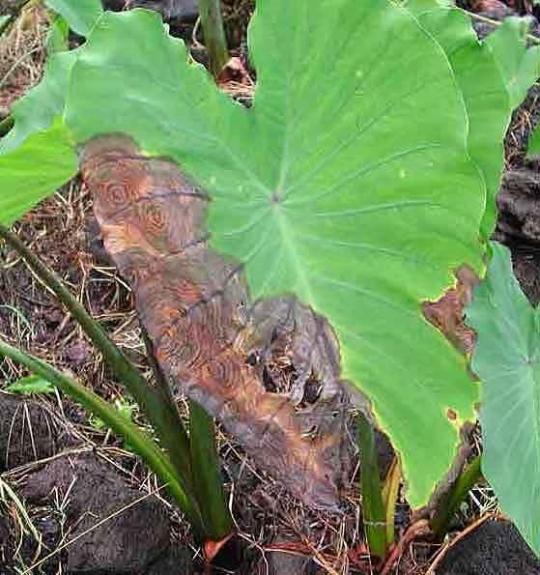
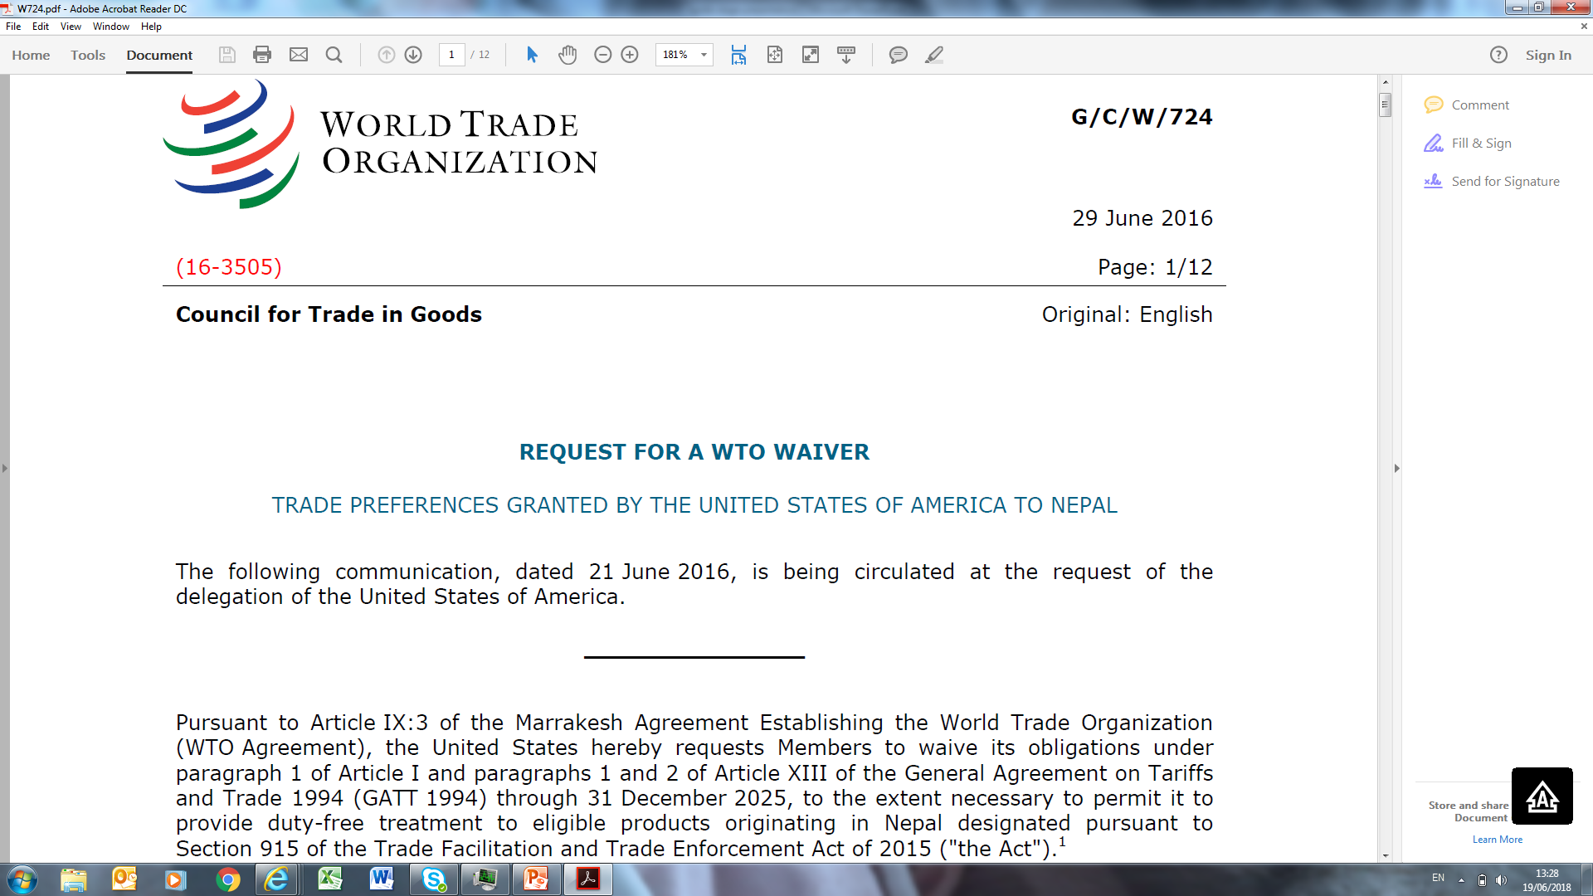
TRADE MEASURES CAN BOTH HELP AND HINDER

Slide 6
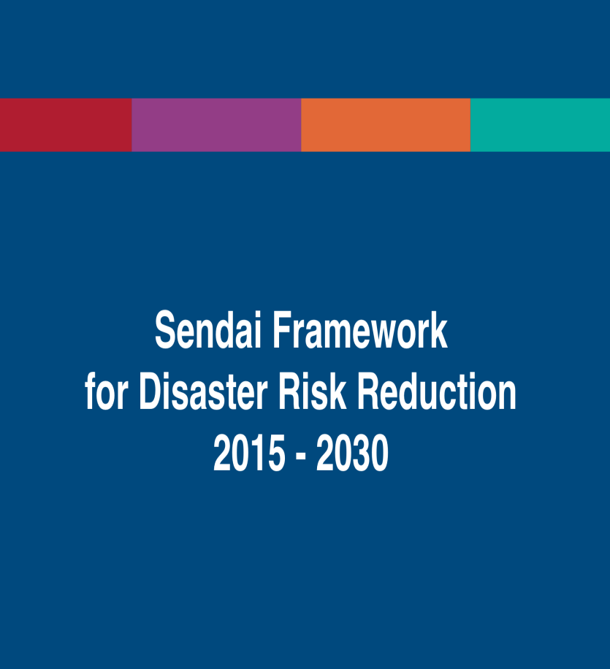
SENDAI TARGETS – TRADE DIMENSION?
Understanding disaster risk
Strengthening risk governance to manage disaster risk
Investing in disaster risk reduction for resilience
Enhancing preparedness for effective response and “Build Back Better” in recovery, rehabilitation and reconstruction
Notes:
Transmission of shocks through global supply chains. (goods and services). Thai floods and Japanese earthquake. Tourism shocks. Less studied perhaps. Hugely relevant for many small economies and LDCs.
Reduce direct economic losses in relation to global GDP by 2030
Multi-hazard early warning systems
Trade as a percentage of GDP over 100% in many countries.

Slide 7
TRADE ISSUES AND RESILIENCE – SOME IDEAS
Specific provisions in agreements (e.g. Agriculture)
Waivers for Exceptional Circumstances (e.g. Art. XIII)
Voluntary standards and mandatory regulations (TBT)
Provision of services related to resilience (GATS)
Environmental goods (e.g. on-going EGA)
Government procurement (plurilateral)
Ex ante approaches, ex post solutions

Slide 8
We want to hear from you
Questionnaires:
Organisations involved in response, recovery and resilience:
https://www.surveymonkey.com/r/NaturalDisastersOrg
Disaster-affected governments: https://www.surveymonkey.com/r/NaturalDisastersCountries
Or email me:
michael.roberts@wto.org

