Slide 1
Animals in Disasters
Project Plan 2018

Slide 2
Global: UNISDR & IFRC
Reg: CEPREDENAC, AHA, SAARC, AU
Clusters of Countries
Online/offline training
Drills, Awareness
Capacity Building
Best practices
Legal Frameworks
Parterning
IAiD
Initiative
Education & Mobilisation
Catalizing Solutions

Slide 3

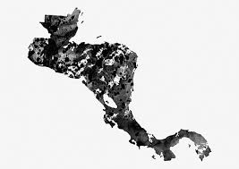
Glocal Approach
Americas Priorities:
Co-implement:
  CEPREDENAC
  Capac. Building w/IICA
Engage:
  IFRC Reg. Panama
  Central American Red Cross socs.
Kenya Priorities:
Co-implement:
  AU & AWSA
Engage:
  IFRC Reg. Kenya
  Kenyan Red Cross
Twitter Conferences

