Slide 1
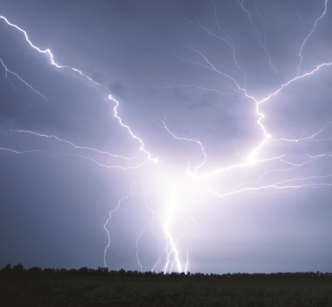
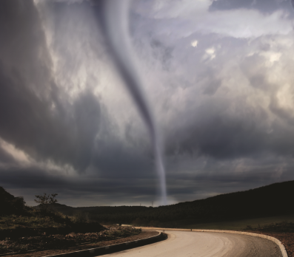
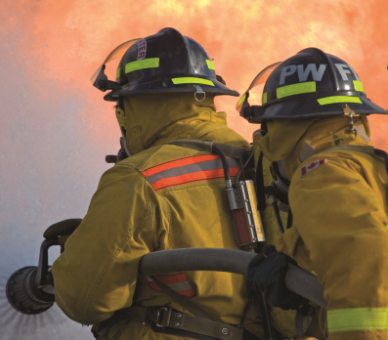
Canada’s Platform for Disaster Risk Reduction
Fifth Regional Platform for Disaster Risk Reduction in the Americas
Montréal, Québec
March 9, 2017
RDIMS 2131292
#CDNDRR #SendaiAmericas

