Slide 1
Canadian Public Safety Innovation Network
Rodney Yip March 2017
Fifth Regional Platform for Disaster Risk Reduction
A collaboration of:
Ryerson University
University of Ontario Institute of Technology (UOIT)
Durham Regional Police Services

Slide 2
Mission of Canadian Public Safety Innovation Network
Create a nationally recognized incubation and innovation network to support the development and adoption of technology and policy to improve the safety of Canadian citizens through the First Responder Community.
Solutions Development + Solution Adoption = Innovation
(Research + Development+ Commercialization)
+
( Contribution + Training + Culture + Skill)
= Innovation
This will be achieved through a partnership between Durham Regional Police Services, Ryerson University and University of Ontario Institute of Technology.

Slide 3
Challenges in Public Safety & Benefits of CPSIN
Challenge
Disconnect between innovators and first responders
Slow acceptance of new technology
Staffing costs
Changing community needs and awareness of first responder activity
Difficult market to access
Demanding use cases and reliability standards
How CPSIN can address….
Lower barriers to help connect stakeholders
Allow first responders to become involved with or aware of the technology development process
Create an eco-system for training future/current first responders and staff
Facilitate the creation of new technology
Create an easy access point to first responders to show how they are trying to improve public safety
Lowers barriers to introduce new technology and policy to first responders
Ensure the quality of new technologies
Benefit
Builds connections to ensures real challenges are being addressed
Improves adoption and acceptance by getting users involved in development
Reduces training and recruitment costs
Improves the efficacy and efficiency of first responders
Improves transparency between first responders and community
Reduces costs of identifying new technologies and insights on changes in the community. Builds credibility with First Responders
New technologies meet the requirements of first responder community

Slide 4
Solution
A series of programs designed to facilitate innovation in public safety supported by a network of resources and personnel.
Based on successful innovation models including PARC and the Ryerson Zone network

Slide 5
CPSIN – Proposed Ecosystem Framework
Public Safety Co-Working Facilities
Program 7 - Round Tables
(Network and Discussion Forums)
Academic Enrichment
Technology Development & Commercialization
Program 1 - Co-development Lab
(Academic Research for insight and technology development : N-CART)
Program 6 - Pilot Programs
(Tech integration)
Program 3 – Needs Identification Programs
(Talent Identification, I-Corp)
Program 5 - Testing/Certification/Training Program (Security and Functionality validation)
Program 2 - Curriculum based solution development (Capstone, Super Course)
Program 4 -Acceleration/Incubation programs (Mentorship, Connections )
Train academic partners and connect the research with industry needs and expertise
Is this a model we build from? If no where do we start?

Slide 6
Canadian Public Safety Innovation Network
Programs
Program 1 - Co-development Lab
Program 2 - Curriculum based solution development)
Program 3 – Needs Identification
Program 4 -Acceleration/Incubation programs
Program 5 - Testing Program
Program 6 - Pilot Programs
Program 7 - Round Tables
Resources and Capabilities
Space | Personnel | Tools
DRPS (The HUB) Co-working and meeting spaces UOIT Co-working and meeting spaces Test Facility RYERSON UNIVERSITY Co-working and meeting spaces | First Responders Business Mentors Entrepreneur in Residence Community stakeholders Staff | Public Safety Spectrum Access to Data First Responder equipment Testing Facility
Operations: Governance, Finance, Marketing/PR, Business Development
Partners: Universities, Colleges, Industry, Governments, First responders
Founding Partners: DRPS, Ryerson University, UOIT

Slide 7
Partners
Founding Partners to work together to identify key partners
Partners under consideration:
Police
Fire
Emergency Medical
Search and Rescue
Colleges
Municipalities
Provincial and Federal government
Tech companies and Current Vendors
Community Groups

Slide 8
Initial Funding and Sustainability
Grants (Programing and Research)
Contract research
Institutional funding
Sponsorship model for partners
Revenue through pay-as-you-go access to tools offered

Slide 9
Summary
Mission
Create a nationally recognized incubation and innovation network to support the development and adoption of technology and policy to improve the safety of Canadian citizens.
How we can do this
Incubation space at DRPS facility to create easy access to First Responder Community
Testing and Co-working space at UOIT and Ryerson
Curated programing to ensure innovators and first responders interact and leverage resources provided
Focused research into the needs of public safety and solution development

Slide 10
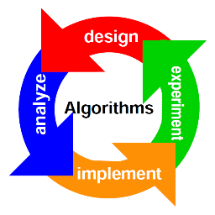
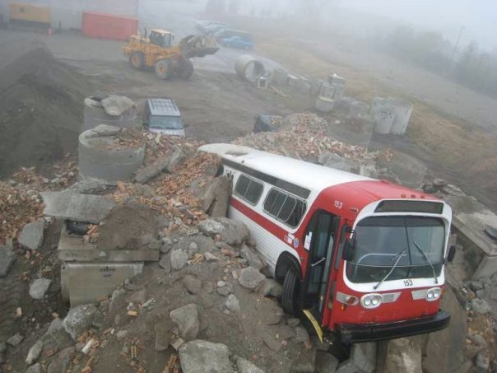
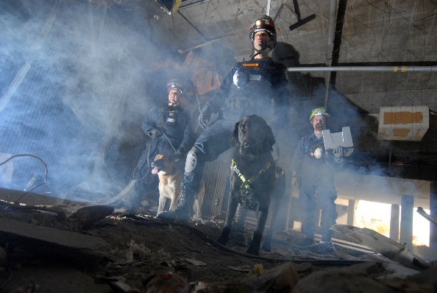
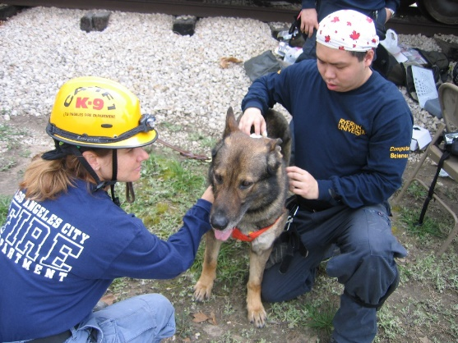
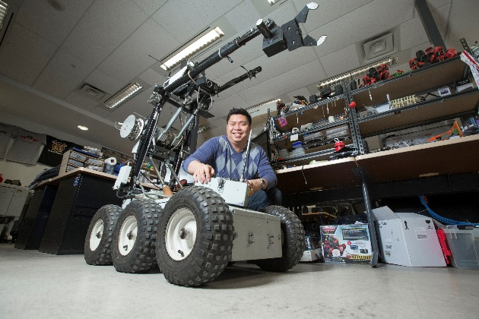
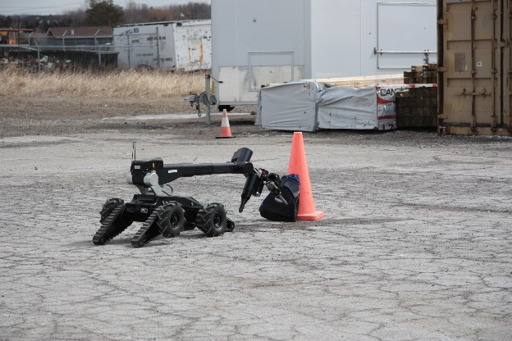
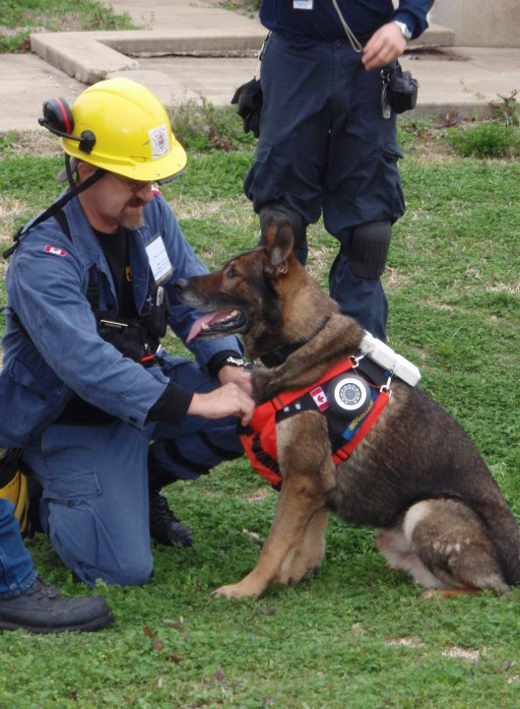
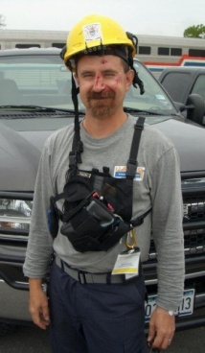
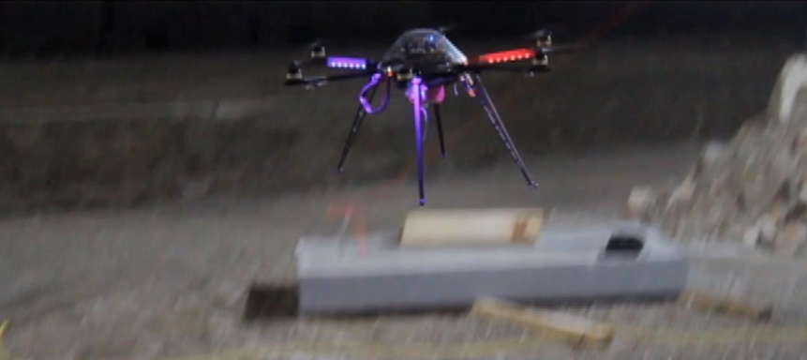
Network-Centric Applied Research Team (N-CART)
the application of computational resources, theory and practice in support of and improvement to PS processes.
Multidisciplinary R&D by
Graduate, Undergraduate Students and Volunteers
Collaborating Organizations
Others
Focus on Computational Public Safety (PS)
Director: Alex Ferworn
Computer Science Professor
Canadian Army – 14 years
OPP Auxiliary - 2 years
Strategic Advisor: Rodney Yip
IBM Canada – 33 years in Disaster Recovery Business Continuity and Emergency Management
Not a typical computer science lab
“Dogs and Robots”
“Innovation at the speed of business not government”
“Best kept secret in Canada”
John Hickenlooper, Governor - Colorado

