Slide 1
Canadian Risk and Hazards Network (CRHNet)
Established 2003

Slide 2
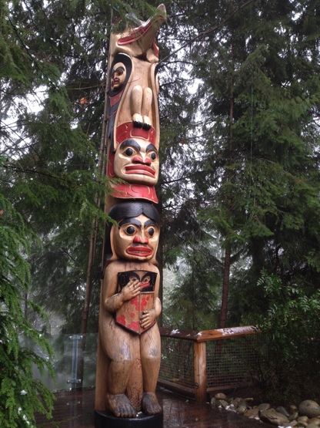
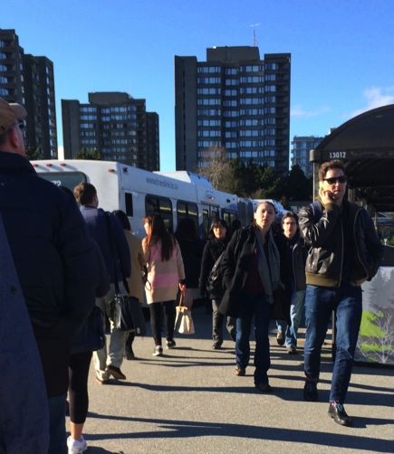
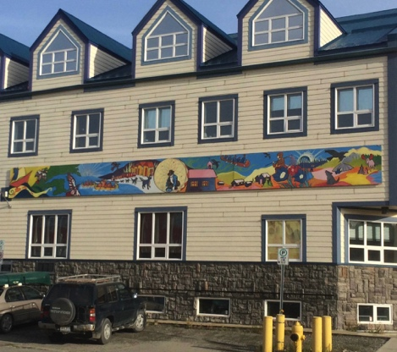
Vision
CRHNet creates an environment for
Early Career Professionals;
Researchers;
Educators; and,
Practitioners
to share innovative approaches and building best practices to reduce disaster vulnerability in Canada

Slide 3
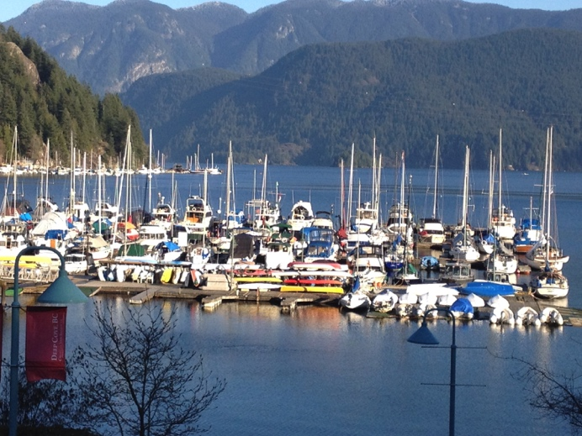
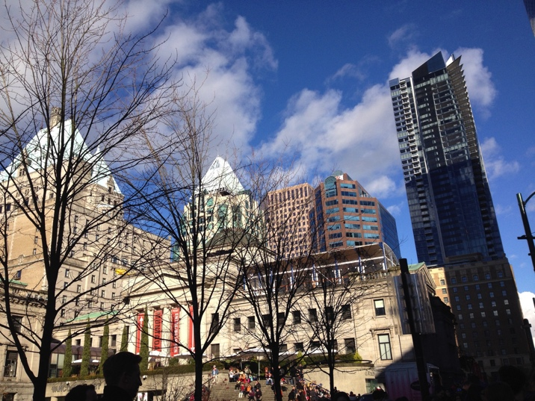
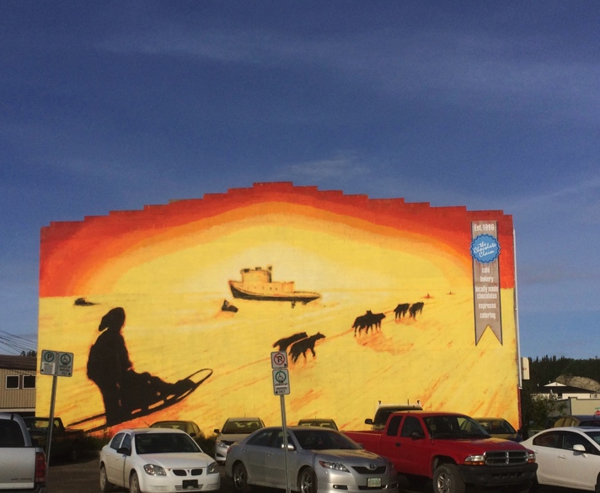
Goal
To create a safer and more resilient
Canada
“Reducing Risk through Partnerships”

Slide 4
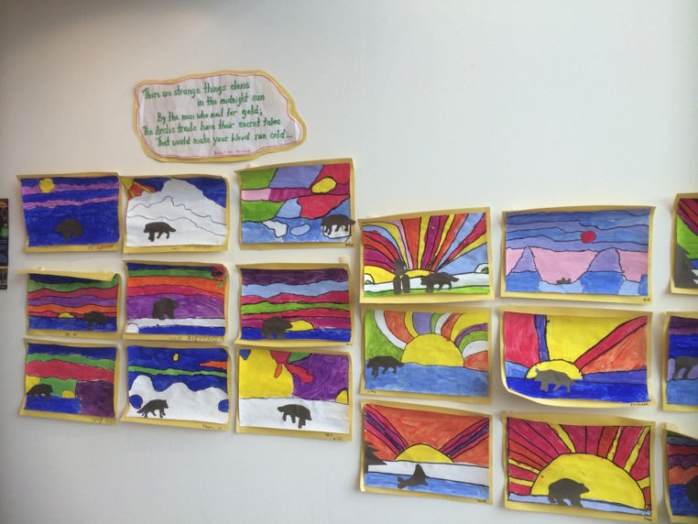
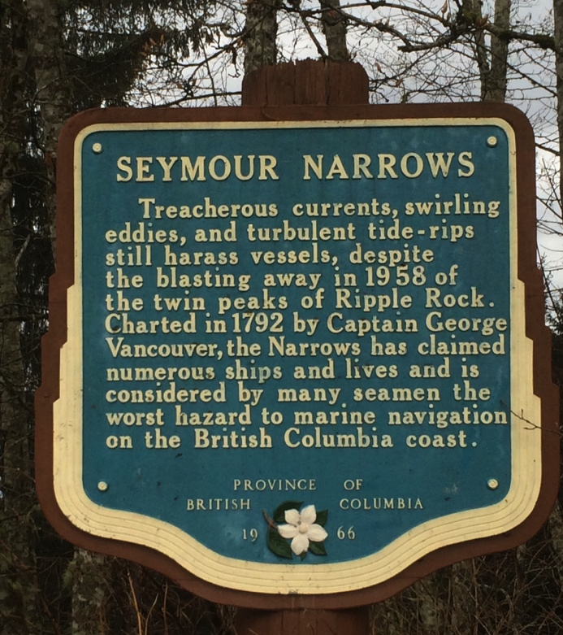
Purpose
CRHNet assists in disseminating lessons learned, knowledge, methods and tools,
with a view to reducing disaster risk and building community resilience.

Slide 5
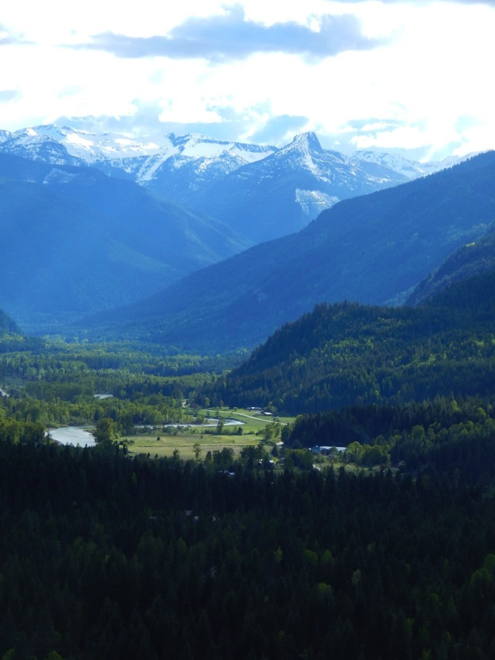
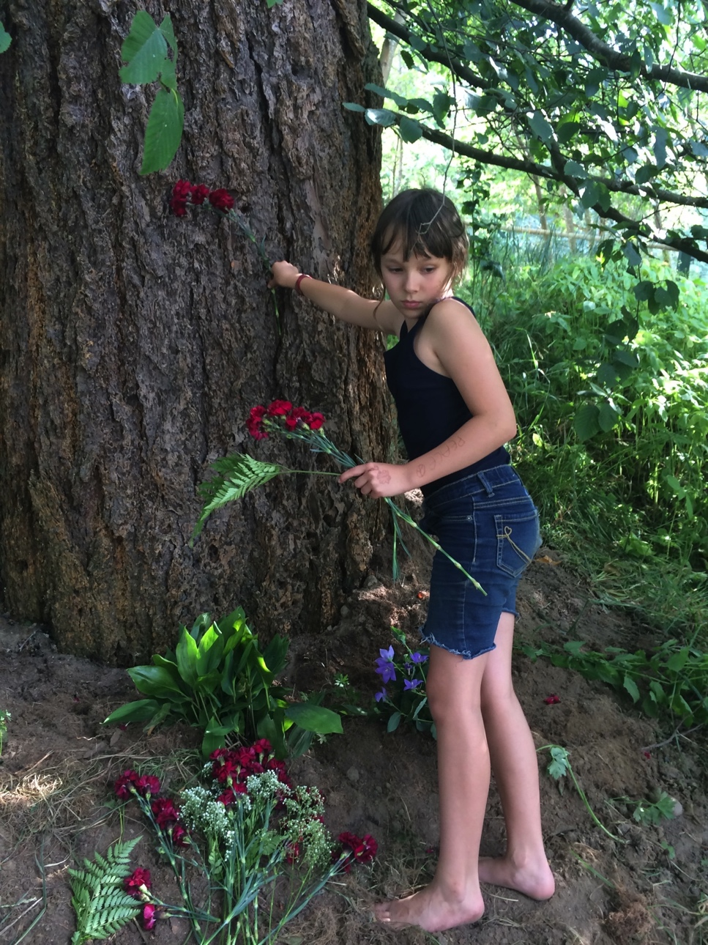
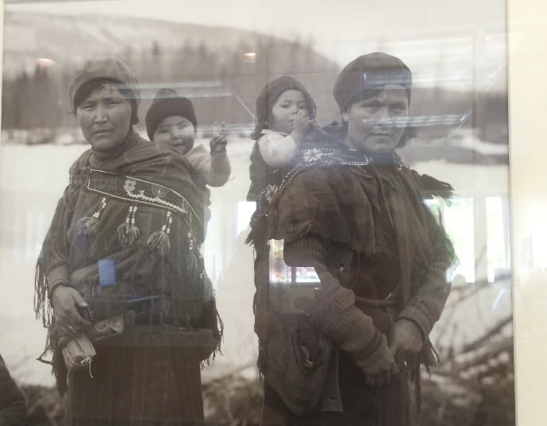
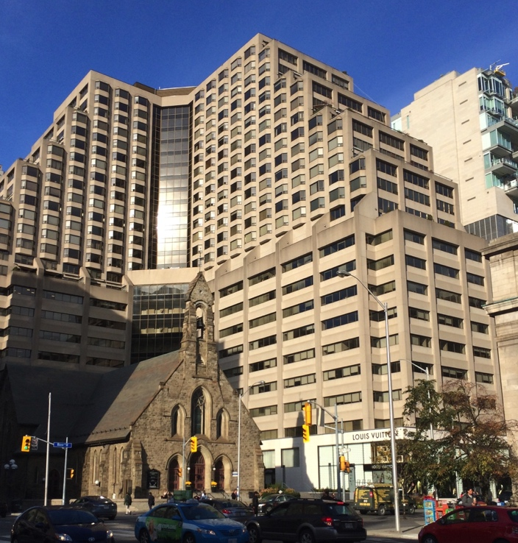
Objectives
Help build Canadian capacity to deal effectively with threats and consequences from all hazards.
Promote, develop and facilitate disaster resilience across Canada.

Slide 6
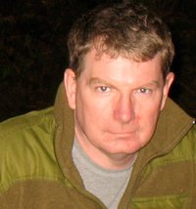
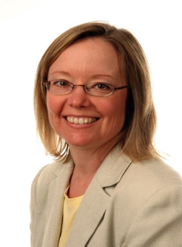
Governance
CRHNet is an incorporated national association.
The volunteer board of directors is drawn from a cross section of Canadian academics and practitioners in the field of hazard risk management and research.
Ernie MacGillvray
Patricia Martel
Judith Muncaster
Brenda Murphy
Shona de Jong
David Diabo
Michel C. Dore
Gale McMahon
Jodi Manz-Henezi
Mark Seemann

Slide 7
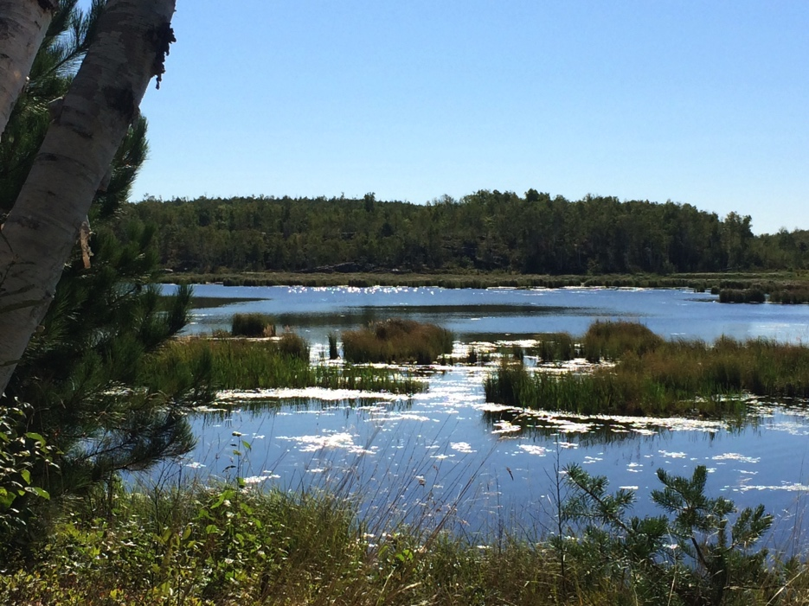
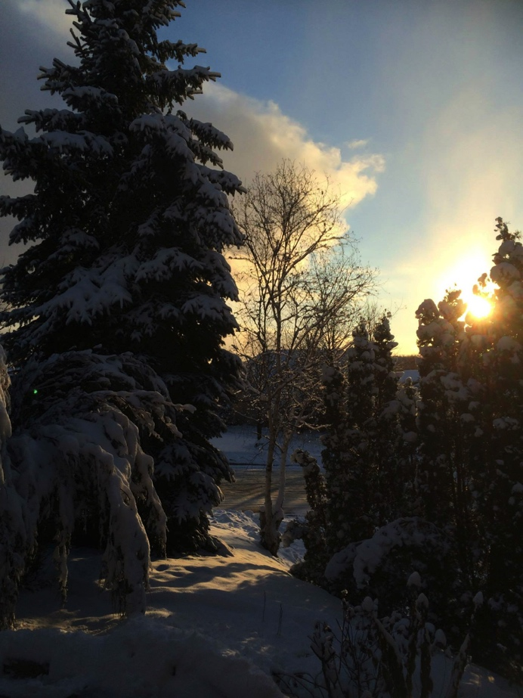
CRHNet Board
Monthly teleconference (last Friday of each month)
President, Vice-President, Secretary, Treasurer & hired Executive Director form the Executive
Standing Committees: e.g. Awards, HazNet, Membership, Communication, Symposium
Meeting minutes, agendas are available to the public.

Slide 8
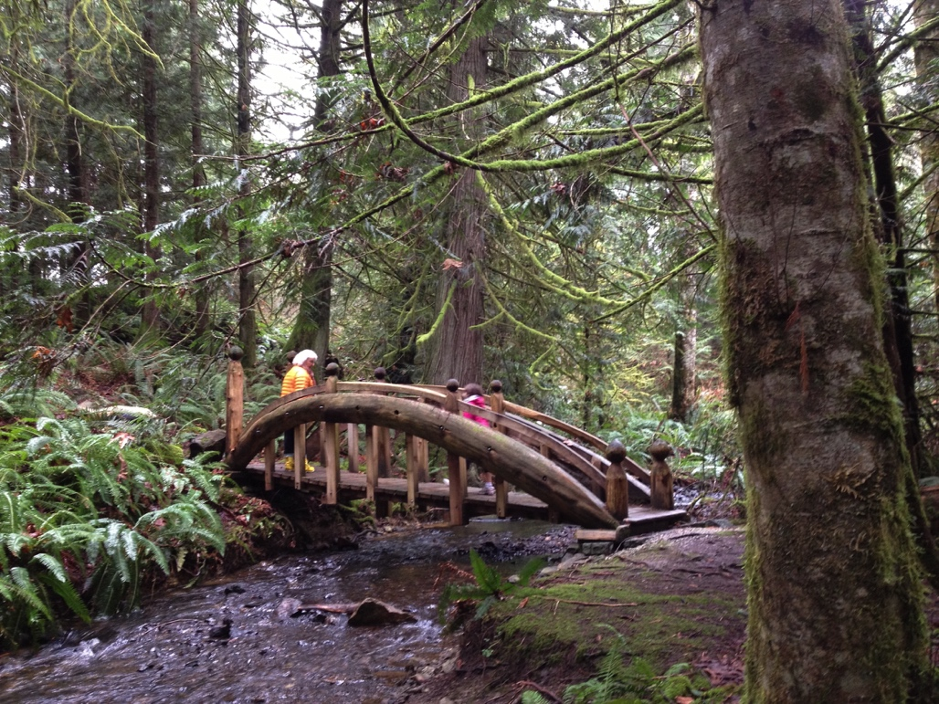
CRHNet Structure
Employs an Executive Director responsible for the day-to-day administration of the organization
CRHNet is registered federally as a not-for-profit corporation
Financial reports and operating statements are produced monthly in accordance with the terms of the corporation
CRHNet holds an Annual General Meeting at its annual Symposium

Slide 9
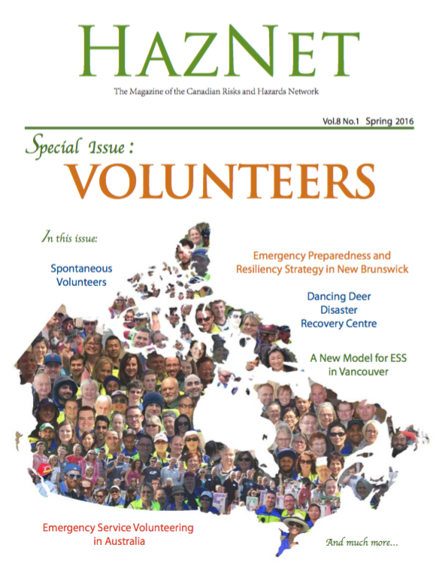
Programs/Initiatives
Annual Symposium
HazNet
Young Professionals
Awards
Mentorship
Academic Network

Slide 10
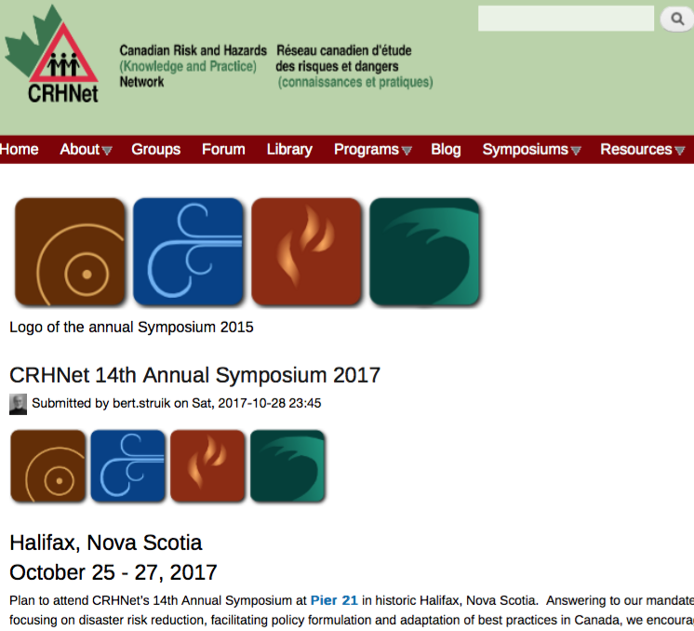
Web Site
www.crhnet.ca
Library
By-Laws
Resources
Ongoing research
HazNet Journal Archives
Disaster Management
Textbook
Current + Past Symposia
National Platform for DRR
Social Media networks
much more…

Slide 11
Membership
Annual membership to CRHNet is available:
- Students $25
- Individuals $50
- Academic Institutions $500
- Organizations ranging from
$500 to $25,000

Slide 12
Join Us
Help us make a safer Canada and a safer world!

Slide 13
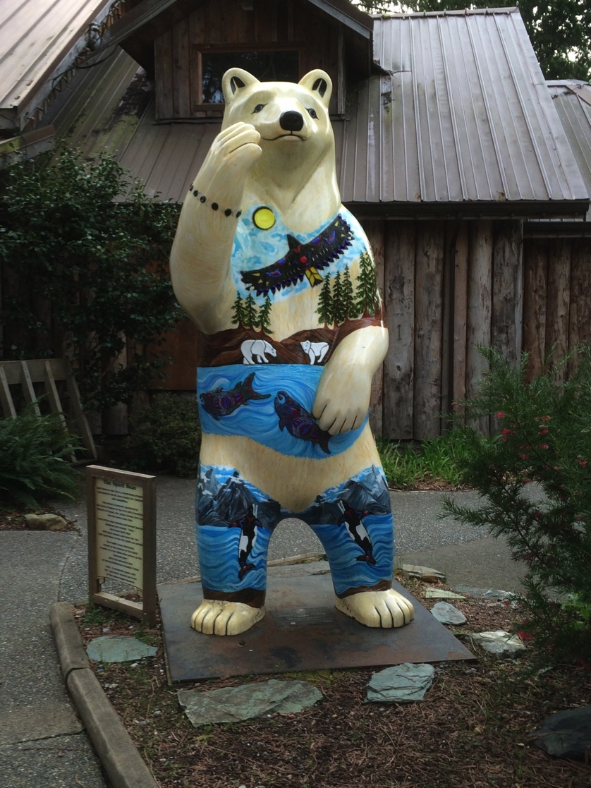
Why Join?
Help develop a vibrant community of people who mitigate risk and hazards and improve emergency and disaster management.
A reduced registration fee for the annual CRHNet Symposium
Access to the CRHNet member database

Slide 14
Questions?
For More Information Please Contact:
Brenda Murphy, bmurphy@wlu.ca
Marion Boon, execdir@crhnet.ca

