Slide 1

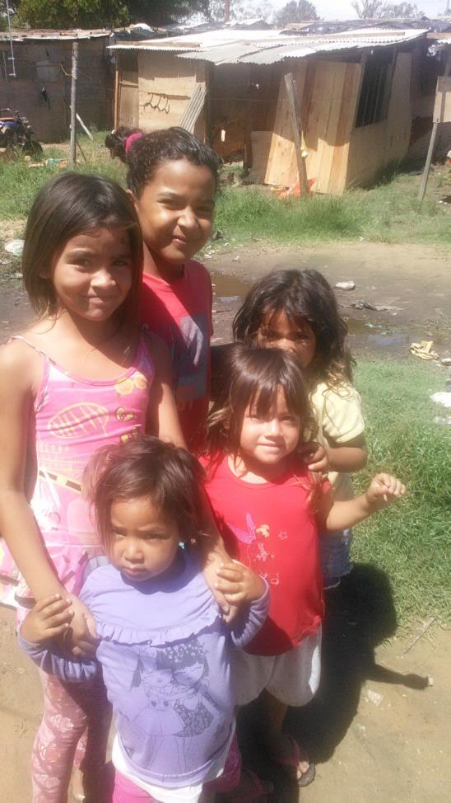

Humanitarian Aid &
Civil Protection department
Partnerships between public and private sectors for disaster risk reduction in Latin America and the Caribbean
Montreal, March 2017
Notes:
The world-wide trend of more man-made and natural disasters continued unabated in 2015.
When disaster strikes, the EU is among the first to mobilise and to provide emergency assistance.
Throughout 2015, the European Commission's Humanitarian Aid and Civil Protection department (ECHO) responded in parallel to multiple emergencies of major scale.
1992: Creation of the European Community Humanitarian Office (ECHO)
2004: ECHO became the Directorate-General for Humanitarian Aid
2010: Civil Protection was integrated for improved coordination and Disaster Response inside and outside Europe

Slide 2

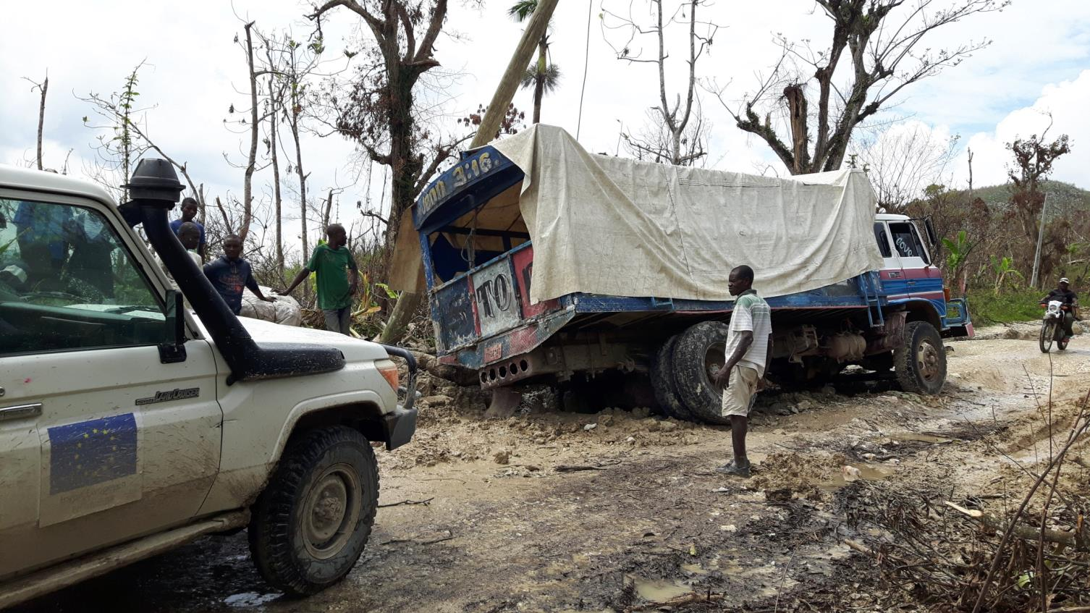
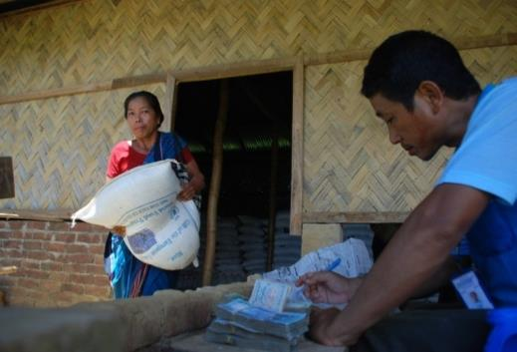
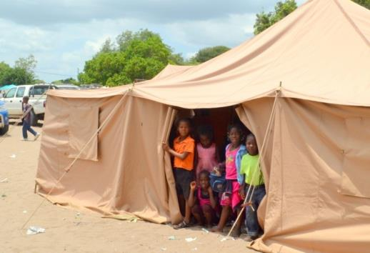
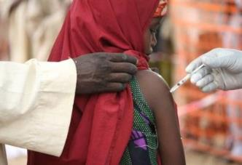
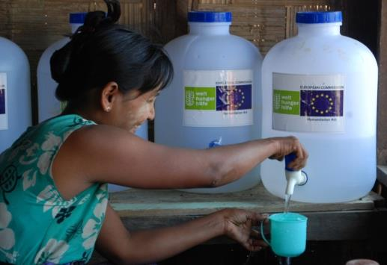
Humanitarian operations funded by ECHO
Food & nutritional support
Basic food supplies
Supplementary feeding for infants
Special rations for malnourished people
Seeds for farmers etc.
Shelter
Tents
Plastic sheeting
Building materials etc.
Medical assistance
Vaccination campaigns
Essential drugs
Hospital equipment
Primary health clinics
Local staff trainings etc.
Water & sanitation
Wells, boreholes, piping
Latrines
Sewage treatment
Hygiene education etc.
Notes:
The consequences of disasters are devastating and varied: lives are lost, housing, crops and livelihoods destroyed.
Humanitarian aid is provided in a variety of forms depending on the nature of the crisis. It can range from food, clothes, healthcare, shelter, water and sanitation to emergency repairs to infrastructure, demining actions, psychological support and education.
All of these ECHO funded projects share one common aim: to alleviate the suffering of the affected populations.
Food assistance: tackling malnutrition and food insecurity via food supplies, cash or vouchers
Examples include emergency rations for people displaced in a conflict and special feeding for malnourished children in drought-affected areas. ECHOs food assistance also aims at boosting livelihoods in regions of food insecurity.
The EU seeks to ensure that vulnerable people have access to safe and nutritious food during times of crisis.
In recent years, it has spent more than 40 % of its humanitarian aid budget on food assistance.
For example, over the past decade, EU assistance has been provided to the Sahel region in West Africa. In 2014 alone, 1.7 million people in a dire state of hunger received help, along with 580 000 severely malnourished children.
Tents and other types of shelter for those people whose homes have been destroyed in a conflict or natural disaster
Natural disasters such as floods, tropical storms and earthquakes can destroy people’s homes in an instant.
Man-made crises like armed conflict can also rapidly displace civilians as they flee from fighting.
People need protection and a safe place to stay.
The EU is well aware of the importance of these needs and spends over 10 % of its humanitarian aid budget on providing shelter in disaster-hit areas across the world.
Healthcare to crisis victims:
Keeping people healthy during a humanitarian emergency is a major challenge. If left undiagnosed, diseases such as diarrhoea, malaria and tuberculosis can wreak havoc on vulnerable populations.
Working with its international partners, the EU’s first priority is to limit preventable deaths and disability which can stem from emergency situations.
With EU support, basic health care is provided to crisis victims with an emphasis on people particularly at risk such as pregnant women and infants.
In earthquakes and war zones, emergency medical teams are deployed to treat injuries
After an emergency, it is imperative that action is taken to bring local healthcare services back to speed as soon as possible in order to secure basic day-to-day healthcare.
The EU provides some EUR 200 million per year to support humanitarian health operations across the world, amounting to approximately 30 % of all global spending on this one issue.
The funding addresses a range of often interrelated needs, from treating malnutrition and injury to providing safe water supplies and immunisation programmes for children.
Very soon after a disaster strikes, people need access to clean drinking water to prevent the spread of diseases.
The same objective lies behind the provision of hygiene and proper sanitation facilities.
Poor water, sanitation and hygiene – known as WASH in humanitarian aid circles – cause about 1.7 million deaths across the world every year.
The EU provides about EUR 200 million per year from its humanitarian aid budget to address people’s water needs.
The EU has contributed to maintaining a number of regional warehouses (in Panama, Italy, Dubai, Ghana and Malaysia) where water stocks are immediately available for future emergencies.
Moreover, rapid response teams can be deployed within 72 hours of a crisis to asses, manage and coordinate WASH requirements.
The EU also helps in the deployment of sophisticated equipment, such as water pumps and purification systems, to replace damaged sanitation infrastructure.

Slide 3
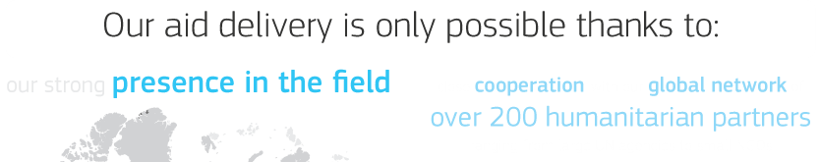


Main partners in Latin American & Caribbean region since 1994
RESPONSE IN LAC
DP- RESILIENCE IN LAC
Notes:
Humanitarian Partners
In partnership with these humanitarian organisations ECHO has a fast response capacity allowing funding and staff to be rapidly deployed to where help is most needed.

Slide 4


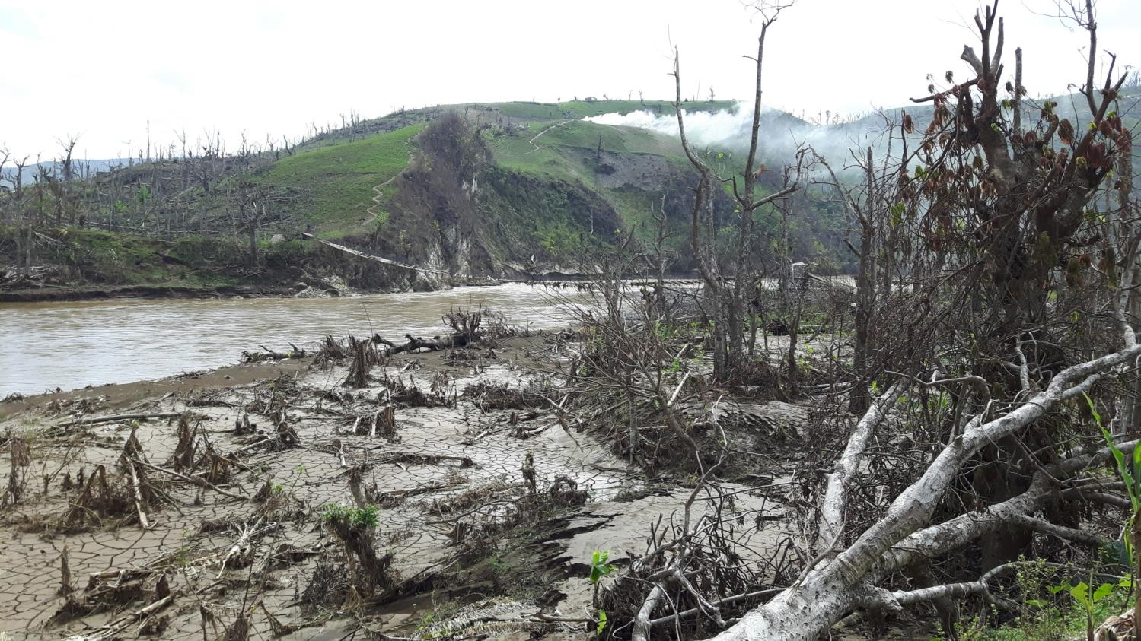
We Invest
Notes:
Beyond the immediate relief activities in direct reponse to a humanitarian crisis, ECHO helps affected communities to better prepare for and prevent future disasters; while strengthening the resilience of local populations. Most natural catastrophes are impossible to prevent. But their negative impact can be reduced, for example by establishing early warning systems or evacuation plans, training in earthquake resistant building techniques etc.
Building resilience is an effective way of reducing loss of life and property during an emergency.
Preparing for the worst is also much more cost-effective than just waiting to respond to the next disaster.
The EU integrates resilience into the projects and programmes which it funds around the world.
EU policies in areas such as climate change, disaster risk reduction, and the delivery of food and water reflect the need to prepare communities for future challenges.

Slide 5

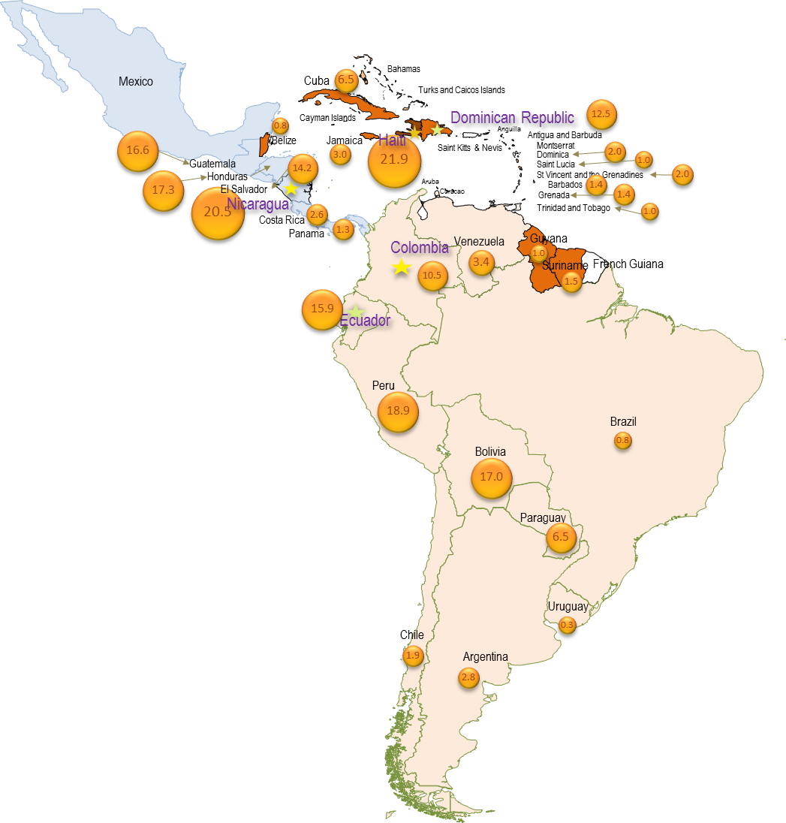

Slide 6





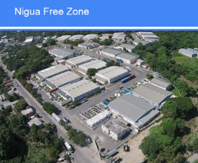
Experiences in the construction of public-private partnerships for disaster risk reduction
AGERCA (2007) 25 companies
PART OF THE SNGRD
Business Continuity Planning
Awareness among the population.
a bridge between the private and the public
COOPI Goal
Santo domingo
Port au
Prince
free emergency calls (to ask the service of an ambulance and other kind of emergency needs)
SMS for prevention measure
Free phones and free SMS for SAT and monitoring of water treatment to fight Cholera risk. PAHO OXFAM PLAN Habitat
3 associations 38+28+26 privates companies
Providing transport, Chlorine training material, space for trainings, developing contingency plan aligned at companies level and communities level. UNDP
Notes:
El sector privado: nombre de la empresa… AGERCA
La actividad principal Is an association of 25 private companies from Haiti. These national companies are affiliate to the association, which is part of the National Risk Management System.
Nombre del socio COOPI-GOAL La localidad (nacional, local … ) Haiti- Port-Au-Prince, Petion Ville, Tabarre
*The association supports the project with additional equipment, materials, transport… ex UNIBANK gave domes, BRANA provided water to a hospital and so on…
El sector privado: nombre de la empresa… DIGICEL
La actividad principal National Communications company
Nombre del socio PAHO
La localidad (nacional, local … ) Binational: Haiti and Dominican Republic
*The Company enables free emergency calls (to ask the service of an ambulance and other kind of emergency needs)
El sector privado: nombre de la empresa… Asociación de Empresas e Industrias de Haina – Assosiation of Companies and Industries from Haina
La actividad principal Is an association of 38 private companies working at provintial level.
El sector privado: nombre de la empresa… Parque Industrial PIISA- PIISA Industrial Park
La actividad principal Is an association of 28 private and International companies
El sector privado: nombre de la empresa… Zona franca de Nigua- Free Zone of Nigua
La actividad principal Is an association of 26 private companies from DR
Nombre del socio UNDP
La localidad (nacional, local … ) Dominican Republic Province: San Cristobal Municipalities: Sabana Grande de Palenque, Bajos de Haina and San Gregorio de Nigua.
*The associations supported the Project with rooms for trainings, training materials, transport, chlorine for vector control, worked coordinately the contingency plans from the companies and the community to be aligned.
El sector privado: nombre de la empresa… DIGICEL
La actividad principal National Communications company
Nombre del socio Oxfam
La localidad (nacional, local … ) Haiti: Cap Haitien, Ouanamninte, Port de Paix

Slide 7



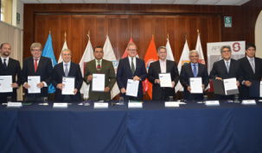

Experiences in the construction of public-private partnerships for disaster risk reduction
Support to obtain work contracts or internships;
Assistance to prepare CVs;
Cash assistance during training;
Donation of productive assets
Trainings,
Facilitating access to formal employment in private and semi-private companies,
Support to small businesses
Bogota
Quito
More than 100 companies y 13 cities
servicios de aseo, hotelería, productos químicos, vigilancia, manufacturas, restaurantes, comercios, auxiliares de enfermería.
Colombia
Peru
Private –public Protocols
INDECI ⬄ GEAD
2011-2012
WFP linkages with Private sector for logistic of Food access/and stock.
=> Agreed protocols for emergency response.
2013-2014
Update private public protocols - increase # companies involved.
2015-2016
Moving from working with a private company to a business federations to
a Disaster business support “cluster” which group 12 business federations /associations
Grupo Empresarial de Apoyo en Caso de Desastres
Notes:
Income generation support – ICRC Colombia: Years 2014, 2015 and 2016.
Objective: Individuals affected by the armed conflict or OSV who have been displaced towards urban areas improve their opportunities and capacities to generate income through vocational training and/or obtained short-term employment at private companies.
Beneficiaries: Around 1,000 households (4,000 individuals) per year.
Indicators:
- Number of households benefiting from the Income Support program.
- Number of beneficiaries that attended a vocational training.
- Number of months on average that income support is received.
- Average financial support received per capita and % that is contributed by the ICRC intervention.
- % of household income generated as a result of the ICRC intervention.
Description:
The program consists of a number of projects in the cities targeted for this program such as: Cali, Popayan, Puerto Asis, Pasto, Bogota, Cucuta, and Florencia. The program aims to increase the income of a displaced family for three to six months primarily through a combination of: vocational trainings, facilitating access to formal employment in private and semi-private companies, and support to small businesses.
Beneficiaries’ participation in the project is staggered throughout the year and lasts three to six months. For vocational training, a study of the different trainings available and the local demand in terms of skills is undertaken to increase the likelihood of beneficiaries securing work after completion of the training. Cash assistance can be provided to beneficiaries during the training for transport and food. ICRC has partnerships with SENA and other training facilities to deliver the training to the beneficiaries. Partnerships with private enterprises that offer on-the-job training are also a key part of this program.
For employment opportunities, support to beneficiaries is also provided to elaborate CVs and complete required medical checks. Short workshops are delivered by ICRC and SENA that help beneficiaries preparing to enter the workforce. Companies that offer employment with few requisites are identified and welcome to this program. ICRC assists beneficiaries to buy uniforms and other items needed for the job as well as cash assistance during the first month of employment before the first salary is received. ICRC visits beneficiaries at their place of work to discuss with them and with company representatives about the process and follow up any problems.
In summary, ICRC provides:
- Support to obtain work contracts or internships;
- Contributions to beneficiaries' salaries;
- Workshops on preparing to enter the workforce;
- Assistance to prepare CVs;
- Assistance to cover the cost of medical checks, photos, uniforms and other requisites;
- Payment of vocational training fees;
- Cash assistance during training;
Donation of productive assets (materials, products, equipment, tools, etc.) as part of support to an MEI project.
More than 100 companies y 13 cities
Diamante (servicios de aseo), Marriot (hotelería), Sigla (productos químicos), Servidomésticas (servicios de aseo) Datacontrol (vigilancia), Empaques del Cauca (manufacturas), Doce Vita (restaurantes), Segurcol (vigilancia), Chilimaco (hotelería) , Metroalarmas (vigilancia), Torre de Cali (hotelería), Roho Fiesta (comercio), Ancianato Cali (auxiliares de enfermería)
------------------------------------------
PERU
ARTICULACIÓN PÚBLICO – PRIVADA EN TEMAS DE GRD EN EL MARCO DE PROYECTOS DIPECHO DE NACIONES UNIDAS EN EL PERÚ
DIPECHO 2011-2012
El Programa Mundial de Alimentos, en el marco del Proyecto Inter agencial DIPECHO, empezó a promover la vinculación entre empresas del rubro alimentos y logística con las entidades encargadas de la respuesta a desastres: INDECI y Gobiernos Locales. Se suscribieron acuerdos en los que se establecían puntos de cooperación mutua en caso de desastres como apoyo con almacenes, compras de bienes, priorización del restablecimiento de la accesibilidad a las zonas de producción en caso de desastres.
DIPECHO 2013 - 2014
Se trabajaron espacios de información y sensibilización con actores públicos y privados a fin de fomentar el desarrollo de diversos canales de ayuda en forma organizada, para una atención rápida, oportuna y eficiente a situaciones de emergencia, así como también, se promovió la actualización de Convenios público-privados, suscritos en el DIPECHO 2011- 2012.
Es el caso por ejemplo de la realización de reuniones de coordinación para la firma de convenios con empresas privadas: San Fernando, Redondo, Caravela, Beas Hermanos, CYNARA Perú SAC, Agrícola Cerro Blanco, Alicorp, AJINOMOTO, etc., coordinaciones con el INDECI, Municipalidad Metropolitana de Lima a fin de establecer reuniones con la Sociedad Nacional de Industrias y la Cámara de Comercio de Lima.
DIPECHO 2015 – 2016
Se ha ampliado la escala de intervención al trabajar con el Grupo Empresarial de Apoyo en Caso de Desastres – GEAD, que agrupa a 12 gremios empresariales. El GEAD, tiene un Memorando de Entendimiento con el INDECI, en cuyo contexto el Proyecto DIPECHO de Naciones Unidas ha apoyado en el establecimiento de los Lineamientos de Gestión y Protocolos del GEAD. Esto comprende el establecimiento de tres niveles de acción:
Dentro de cada Gremio Empresarial.
Dentro del GEAD.
Articulación del Grupo Empresarial con el Sector Público.
Se han desarrollado también protocolos de comunicación al interior del GEAD y entre éste grupo y el Sector Público, principalmente el INDECI.
En el Gráfico siguiente se puede apreciar la estructura del GEAD.
DIRECTORIO
Actualmente se está trabajando en el desarrollo de los mecanismos de articulación al interior del gremio de la Sociedad Nacional de Industrias y de la Cámara de Comercio de la Región La Libertad.
Con el enfoque adoptado en el Proyecto DIPECHO 2015-2016, se ha pasado de trabajar en la vinculación entre cada empresa y su respectiva autoridad de manera individual, a trabajar a nivel gremial obteniendo un mayor impacto a nivel institucional.

Slide 8

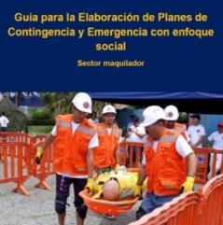

Experiences in the construction of public-private partnerships for disaster risk reduction
http://centrarse.org/
www.icc.org.gt
Managua
more than100 companies
RSE <= DRR
Business Self diagnosis
Model to be diffused => At larger scale.
Technical assistance
an institution founded by the sugar industry
Guatemala
Department of Escuintla
Honduras
Department of Cortes
Maquilas /Workers in confined spaces Exposed to high risks.
Weak-to-no linkage
-4 Business Contingency Plans
-26 Company Emergency Committees were developed representing 18,450 employees.
-827 industrial emergency brigade members, certified by COPECO.
-A total of 70 companies participated in the processes of socialization of risk analysis-DRR
Agreement between COPECO (national DRM institute) and the Honduran Association of Maquilas (HAM).
Development of the "Guide for Preparing Contingency and Emergency Plans with a Social Perspective for the Maquila Sector".
http://www.ahm-honduras.com/?p=10199
Notes:
Working with specific private sector (the Sugarcane industry and Maquilas industry/manufactories)
Guatemala : ACF
The project proposed aims to generate a model of private sector involvement in disaster risk management (DRM) in the Republic of Guatemala, and thus contribute to reducing the vulnerability of populations and institutions exposed to various natural hazards throughout the country, with emphasis on the Department of Escuintla. To do this, the approach adopted by the project is the involvement of the private sector in the Disaster Risk Reduction (DRR) dynamics. This is vital in departments such as Escuintla, where the production of sugar cane, managed by eight companies, accounts in some municipalities for more than 85% of land use. In such contexts, the private sector must be an ally and key player in the process of DRR against floods and others hazards. The project therefore aims to validate, organize and disseminate an intervention model based on public-private partnerships replicable to other areas and risk scenarios of Guatemala and Central America. The action is divided into two components. The first component seeks to increase the number of large Guatemalan companies that incorporate principles of disaster risk management in their operations, and that eventually this influences positively the communities and municipalities where their economic activities take place. The activities in this component will be implemented in cooperation with the Guatemalan Association of Corporate Social Responsibility (CSR). The project's second component focuses on the department of Escuintla, where a big part of its activity will be developed by the implementing partner Private Institute on Climate Change (ICC), an entity sustained by private agri-food companies in the department. All these activities, carried out in the department of Escuintla with private and public sector risk management, will be systemized as a model from which to draw lessons learnt, which later on will be disseminated as widely as possible.
Honduras: TROCAIRE
High number of private companies with high number of workers in confined spaces exposed to high risks. Weak-to-none linkage between private sector and national DRM system. None existent methodology for the development of business contingency plans with social perspective.
DIPECHO IX (2014-2015): Support the Honduran state in clarifying the private sector's role in DRR with a focus on manufacturing companies. Encouragement of the private sector to participate in DRR with national risk management and emergency response systems.

Slide 9
EU experiences in the construction of public-private partnerships for DRR
Conclusions
Not natural for Humanitarian actors
Adapted to context… no recipes – opportunities
Need to adapt the language – DRR is an investment not a cost
Mutual benefits
Complementary
=> provide additional services
=> Facilitate an early recovery
=> scale up the action
Private sector may help the public sector to achieve goals that would not be possible working independently
Synergies between actors multiply the opportunities to learn and to replicate actions, influencing approaches and change practices

Slide 10
Recommendations
Find space to integrate the private sector (PS) as a key actor
In the Response
In DP & DRR
Can make the difference in building the resilience of communities
To do it efficiently the PS should also do it in a coordinated manner
Develop a strategy for engaging with the private sector
Engage private sector directly in advancing in DRR efforts

Slide 11
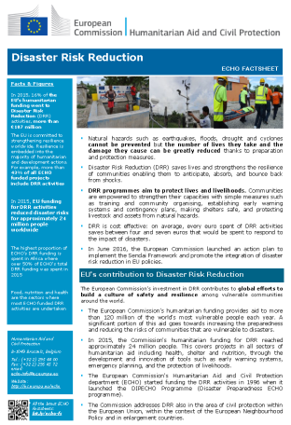
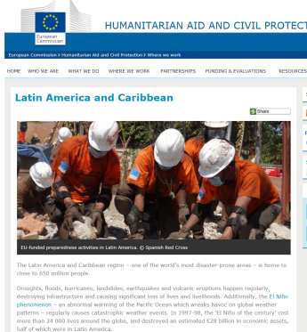
For more information
Website: http://ec.europa.eu/echo/
Factsheets: http://ec.europa.eu/echo/aid/factsheets_en.htm
Thank you!
Notes:
On the ECHO website you can find blogs, articles and background information.
More than 70 factsheets in different languages which are updated regularly.
ECHO Factsheets provide an overview on a specific theme on which we work or country in which we are present.

