Slide 1

EU Resilience Approach
in Latin America and
the Caribbean
Montreal, March 2017

Slide 2
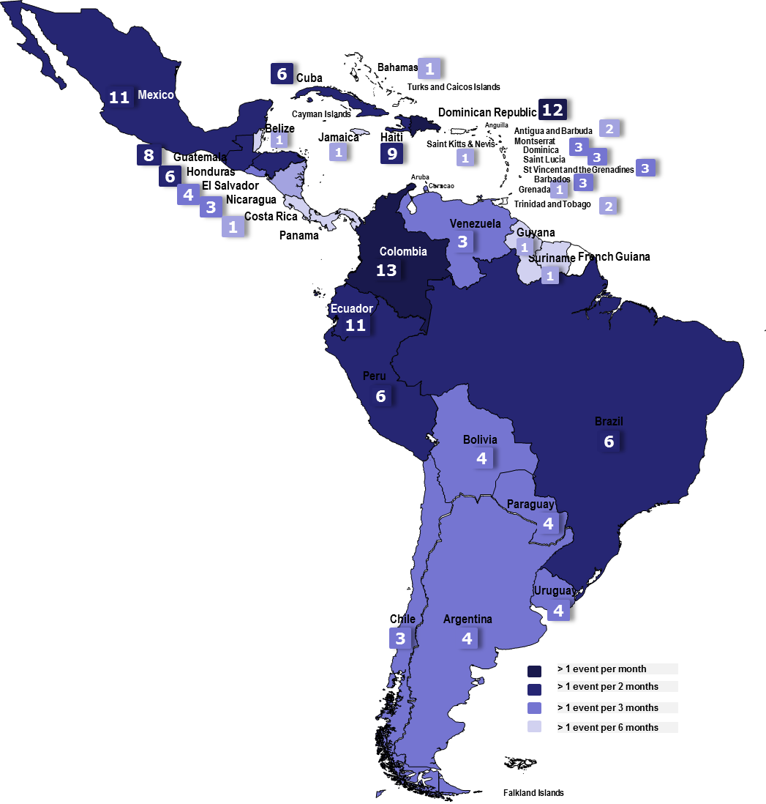
Events/warnings
144 events - (12/month or 3/week)
In 33 countries
Registered by ERCC
daily flash From January to December 2016
(12 months period)
2016
Notes:
Why do we work DRR and Resilience → see occurence of events … prepare for early action

Slide 3
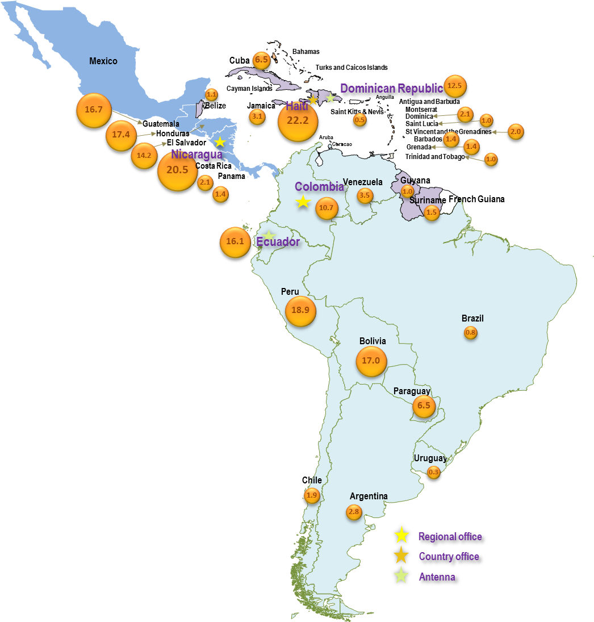
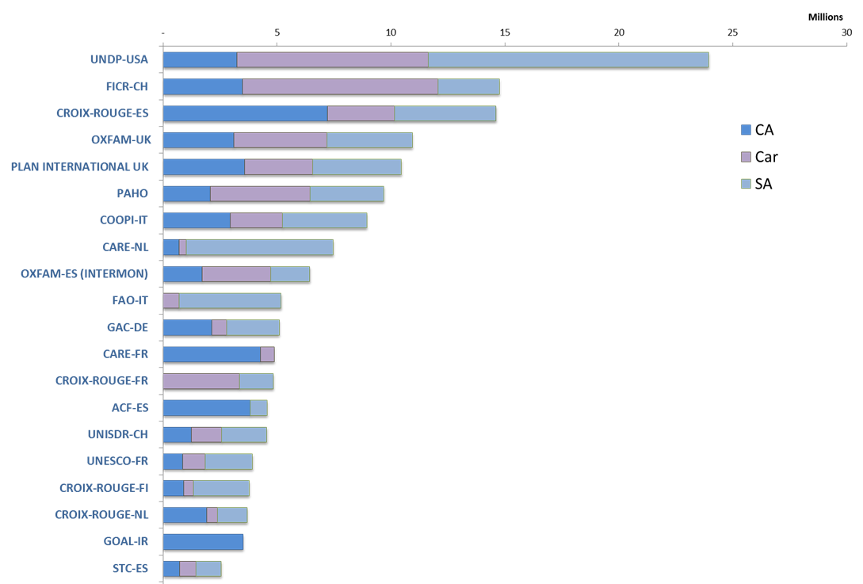
>20 years of ECHO Disaster Risk Reduction in L.A.C. 1996-2016
An investment of 210 Million € and 509 projects to improve disaster preparedness capacities
Our 20 main partners to promote Disaster Risk Reduction during the 1995 – 2016 period
Humanitarian Aid start before the event . No early response without preparedness.
Humanitarian support start in the community putting people first, empowering first responder.
DP is improving coping capacities it is also promoting the right to live in a safe zone, sharing responsibilities and being risk informed.
Action taken at community level inspire upper levels to protect everyone.
Unity brings strength to deliver better together.
Storm Hanna –Floods Ecuador
Earthquake Haiti
Earthquake Peru
Earthquake Ecuador
Earthquake El Salvador
Hurricane Sandy
Hurricane Ivan
Drought
Hurricane Stan
EL Niño 2015-16
Hurricane Mitch
Landslide Vargas Venezuela
EL Niño 97-98
Drought Paraguay
http://www.youtube.com/watch?v=MRX7fUiiZVI
Notes:
5 key messages

Slide 4
Resilience in the LAC region
Disaster Preparedness in ECHO; a learning process
Regional Projects
Local Projects
Action Plans
Targeted
Actions
Results chain; an evolution process
Inputs Activities
Outputs
Outcomes
Goal
Impact
  Technical asist.
  Products
  Services
  Immediate results
  Local coping capacities Improved.
  Dev of tools
  System performance improved.
  Actions taken by Gvt
  Tools tested & used
  DRR mainstreamed
  Long term results by collective actions
  lives and livelihoods better protected.
  Resilience communities/systems
  Losses mitigated

Slide 5
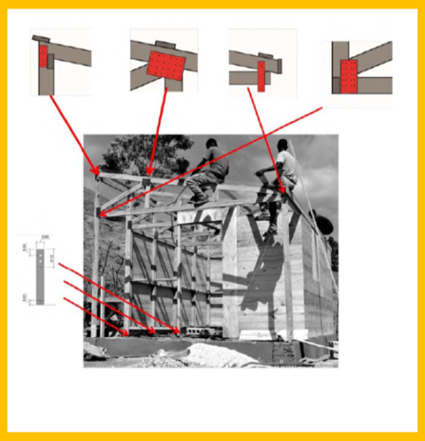
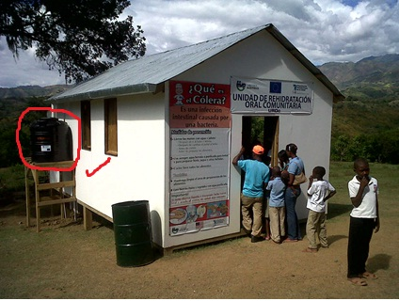
Resilience in the LAC region
Integration of Disaster Risk Reduction in diferent sectors during the response (Water, Health, Shelter)
B. Targeted actions – ex: DIPECHO programme
https://www.youtube.com/watch?v=MRX7fUiiZVI
Notes:
An approach represented by the ECHO resilience marker - To what extent can the project be protected from risks, contribute to efforts to reduce vulnerability – and to avoid recurrence. Straightforward – but requires partnership, a longer term vision and shared responsibilities. NOTE – THE ANSWERS ARE ALWAYS CONTEXT SPECIFIC……………………. What can be done requires – joint analysis and local understanding….

Slide 6
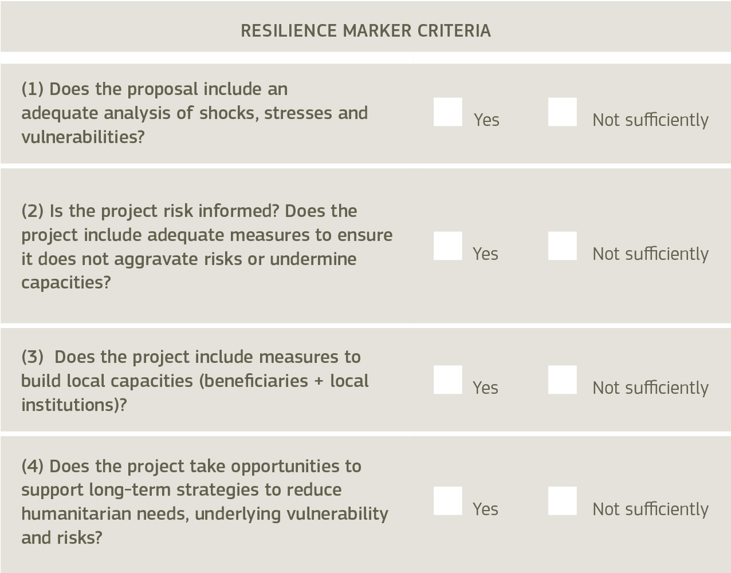
C. Asking key questions before acting
Resilience in the LAC region

Slide 7
Resilience in the LAC region
Supporting the development and implementation of national resilience capacities
Where both EU humanitarian and development assistance are present, the aim is to develop shared assessments, strategies and implementation plans
Promoting innovation, learning and advocacy
Monitoring and research to establish better practice and to scale up or to further advocate for resilience (e.g.: catastrophe insurances)
Improving methodologies and tools
Effective mechanisms and guidance are being developed to support the EU in implementing their resilience commitments (e.g.: INFORM)
Notes:
Main products expected:
At regional level, it is expected to have concrete outputs in Early Warning Systems (through harmonization of protocols and practices, sharing experiences, capitalization of tools), in Information management (compile good practices), in Communication (around these good practices) and in Institutionalization (how these good practices reaches other levels to be further scaled-up or replicated through advocacy).
This is why specific emphasis is put on regional cooperation, exchange of information, capacity building and training and advocacy at national and regional level. Also, Country Documents as a national process to identify priorities will be consolidate to strengthen coordination mechanisms in the region.
Also, sharing lessons learnt and experiences on seismic risk with special focus on urban settlements (urban risk) is a matter of concern for the region and is being implemented (Cuba, Haiti and DR are working on this issue).
Communication tools and methods on DRR are in process to be measured, capitalized and disseminated at regional level.
Regional projects:
1. UNISDR: Implementation of the Sendai framework at local, national and regional levels, though the Regional Mandated body in the Caribbean. Support to the communication strategy on DRR in the region and to the elaboration of country documents.
Main Outputs: New DRR Country Document in Haiti, regional strategies in the Caribbean aligned with Sendai Framework for Disaster Risk Reduction, Communication guideline on DRR disseminated and implemented. Process for country documents consolidated (through official regional decision making) and finally handed over.
2. IFRC: Caribbean Communities Organized and Prepared for Emergencies. Strengthening the auxiliary role of NS in the region, communication and advocacy strategy on DRR best practices.
Outputs: Community Risk Assessments leading to Community Resilience Plans and model validated in the Caribbean (by CDEMA and countries) linking it with Country profiles. Improvement of the regional emergency response mechanism based on disaster response studies (IDRL, logistics, green response). Revision and harmonization of CDRTs validated by CDEMA. Communication strategy implemented and with concrete impact measured (in coordination with UNISDR).
3. UNDP: Strengthening resilience and coping capacities in the Caribbean through integrated early warning systems.
Outputs: Consolidated Alert Protocol EWS Implementation Toolkit based on case studies that lead to an online knowledge sharing platform. End-to-end CAP EWS operational in each country

Slide 8
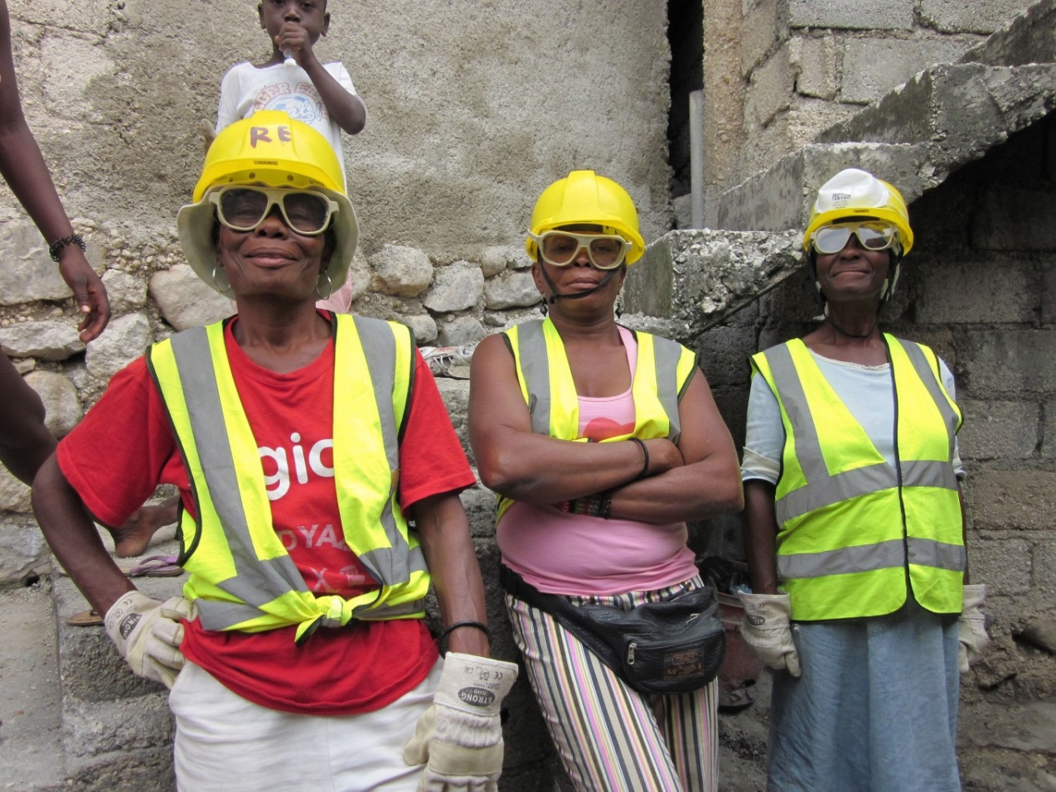
Resilience in the LAC region
Demonstrated impact of well targeted projects to strengthen the capacity
of communities
to address the risks
Concrete short term result approach and local actors as empowered
protagonists
Notes:
Main products expected:
At regional level, it is expected to have concrete outputs in Early Warning Systems (through harmonization of protocols and practices, sharing experiences, capitalization of tools), in Information management (compile good practices), in Communication (around these good practices) and in Institutionalization (how these good practices reaches other levels to be further scaled-up or replicated through advocacy).
This is why specific emphasis is put on regional cooperation, exchange of information, capacity building and training and advocacy at national and regional level. Also, Country Documents as a national process to identify priorities will be consolidate to strengthen coordination mechanisms in the region.
Also, sharing lessons learnt and experiences on seismic risk with special focus on urban settlements (urban risk) is a matter of concern for the region and is being implemented (Cuba, Haiti and DR are working on this issue).
Communication tools and methods on DRR are in process to be measured, capitalized and disseminated at regional level.
Regional projects:
1. UNISDR: Implementation of the Sendai framework at local, national and regional levels, though the Regional Mandated body in the Caribbean. Support to the communication strategy on DRR in the region and to the elaboration of country documents.
Main Outputs: New DRR Country Document in Haiti, regional strategies in the Caribbean aligned with Sendai Framework for Disaster Risk Reduction, Communication guideline on DRR disseminated and implemented. Process for country documents consolidated (through official regional decision making) and finally handed over.
2. IFRC: Caribbean Communities Organized and Prepared for Emergencies. Strengthening the auxiliary role of NS in the region, communication and advocacy strategy on DRR best practices.
Outputs: Community Risk Assessments leading to Community Resilience Plans and model validated in the Caribbean (by CDEMA and countries) linking it with Country profiles. Improvement of the regional emergency response mechanism based on disaster response studies (IDRL, logistics, green response). Revision and harmonization of CDRTs validated by CDEMA. Communication strategy implemented and with concrete impact measured (in coordination with UNISDR).
3. UNDP: Strengthening resilience and coping capacities in the Caribbean through integrated early warning systems.
Outputs: Consolidated Alert Protocol EWS Implementation Toolkit based on case studies that lead to an online knowledge sharing platform. End-to-end CAP EWS operational in each country

Slide 9
Findings on EU support to Resilience
The more committed the country, the more effective, efficient and sustainable the results
Resilience is strengthened through two complementary mechanisms:
the inclusion of DRR during emergencies
the traditional DIPECHO programme
The resilience marker is seen as a solid step forward in terms of strategic thinking
There is a lack of objective comparative studies after the occurrence of stresses and shocks in affected communities showing contribution to resilience
Notes:
Main products expected:
At regional level, it is expected to have concrete outputs in Early Warning Systems (through harmonization of protocols and practices, sharing experiences, capitalization of tools), in Information management (compile good practices), in Communication (around these good practices) and in Institutionalization (how these good practices reaches other levels to be further scaled-up or replicated through advocacy).
This is why specific emphasis is put on regional cooperation, exchange of information, capacity building and training and advocacy at national and regional level. Also, Country Documents as a national process to identify priorities will be consolidate to strengthen coordination mechanisms in the region.
Also, sharing lessons learnt and experiences on seismic risk with special focus on urban settlements (urban risk) is a matter of concern for the region and is being implemented (Cuba, Haiti and DR are working on this issue).
Communication tools and methods on DRR are in process to be measured, capitalized and disseminated at regional level.
Regional projects:
1. UNISDR: Implementation of the Sendai framework at local, national and regional levels, though the Regional Mandated body in the Caribbean. Support to the communication strategy on DRR in the region and to the elaboration of country documents.
Main Outputs: New DRR Country Document in Haiti, regional strategies in the Caribbean aligned with Sendai Framework for Disaster Risk Reduction, Communication guideline on DRR disseminated and implemented. Process for country documents consolidated (through official regional decision making) and finally handed over.
2. IFRC: Caribbean Communities Organized and Prepared for Emergencies. Strengthening the auxiliary role of NS in the region, communication and advocacy strategy on DRR best practices.
Outputs: Community Risk Assessments leading to Community Resilience Plans and model validated in the Caribbean (by CDEMA and countries) linking it with Country profiles. Improvement of the regional emergency response mechanism based on disaster response studies (IDRL, logistics, green response). Revision and harmonization of CDRTs validated by CDEMA. Communication strategy implemented and with concrete impact measured (in coordination with UNISDR).
3. UNDP: Strengthening resilience and coping capacities in the Caribbean through integrated early warning systems.
Outputs: Consolidated Alert Protocol EWS Implementation Toolkit based on case studies that lead to an online knowledge sharing platform. End-to-end CAP EWS operational in each country

Slide 10
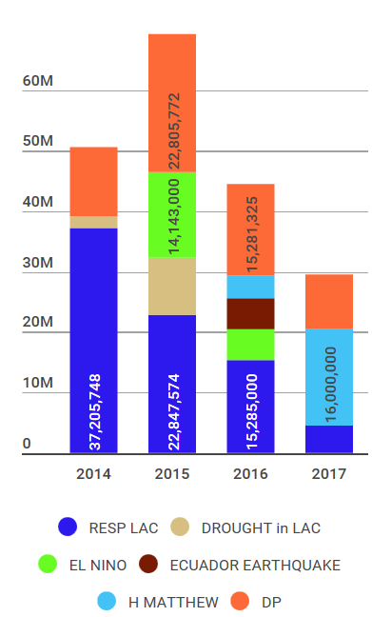
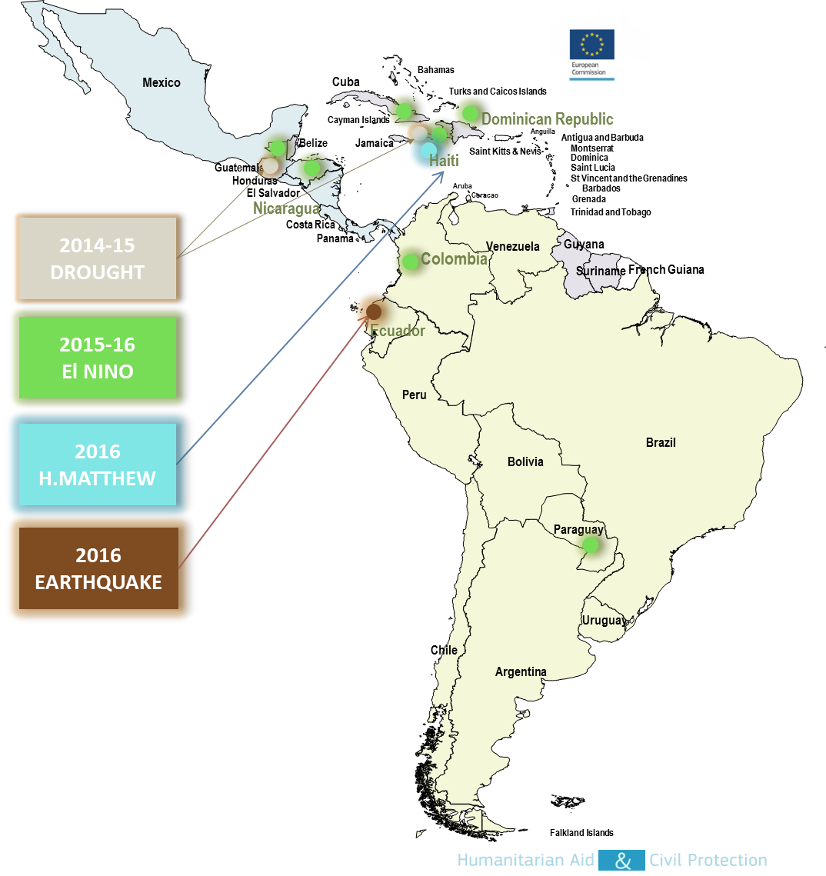
Response to major Events
From 2014 to December 2016
Notes:
Support to major events: the best testimonies on how DP saved lives

Slide 11
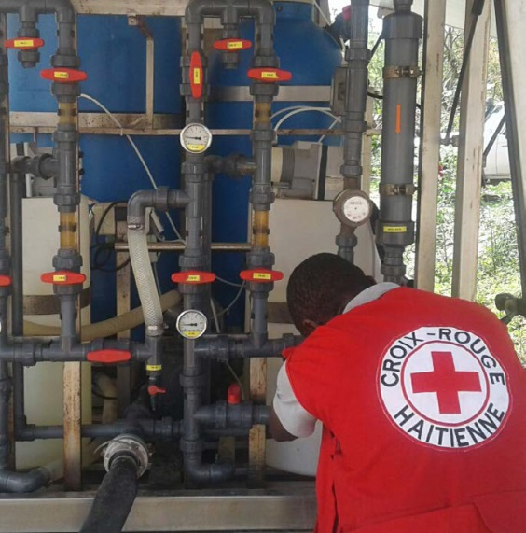
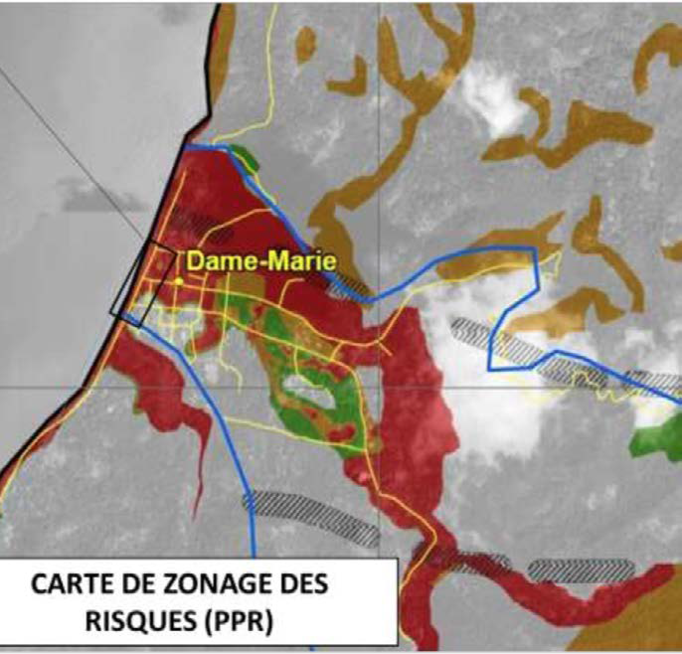
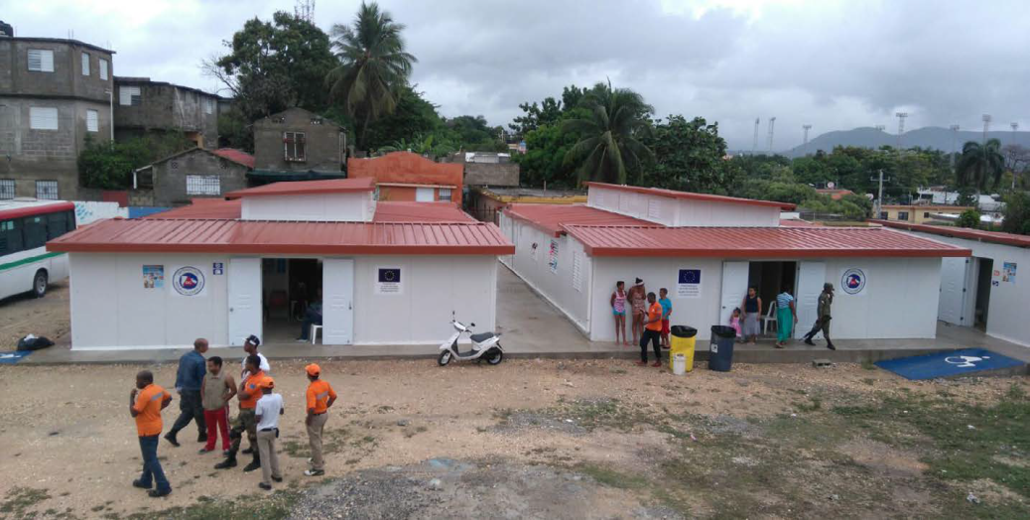
Good practices on resilience Hurricane Matthew 2016
Notes:
Main products expected:
At regional level, it is expected to have concrete outputs in Early Warning Systems (through harmonization of protocols and practices, sharing experiences, capitalization of tools), in Information management (compile good practices), in Communication (around these good practices) and in Institutionalization (how these good practices reaches other levels to be further scaled-up or replicated through advocacy).
This is why specific emphasis is put on regional cooperation, exchange of information, capacity building and training and advocacy at national and regional level. Also, Country Documents as a national process to identify priorities will be consolidate to strengthen coordination mechanisms in the region.
Also, sharing lessons learnt and experiences on seismic risk with special focus on urban settlements (urban risk) is a matter of concern for the region and is being implemented (Cuba, Haiti and DR are working on this issue).
Communication tools and methods on DRR are in process to be measured, capitalized and disseminated at regional level.
Regional projects:
1. UNISDR: Implementation of the Sendai framework at local, national and regional levels, though the Regional Mandated body in the Caribbean. Support to the communication strategy on DRR in the region and to the elaboration of country documents.
Main Outputs: New DRR Country Document in Haiti, regional strategies in the Caribbean aligned with Sendai Framework for Disaster Risk Reduction, Communication guideline on DRR disseminated and implemented. Process for country documents consolidated (through official regional decision making) and finally handed over.
2. IFRC: Caribbean Communities Organized and Prepared for Emergencies. Strengthening the auxiliary role of NS in the region, communication and advocacy strategy on DRR best practices.
Outputs: Community Risk Assessments leading to Community Resilience Plans and model validated in the Caribbean (by CDEMA and countries) linking it with Country profiles. Improvement of the regional emergency response mechanism based on disaster response studies (IDRL, logistics, green response). Revision and harmonization of CDRTs validated by CDEMA. Communication strategy implemented and with concrete impact measured (in coordination with UNISDR).
3. UNDP: Strengthening resilience and coping capacities in the Caribbean through integrated early warning systems.
Outputs: Consolidated Alert Protocol EWS Implementation Toolkit based on case studies that lead to an online knowledge sharing platform. End-to-end CAP EWS operational in each country

Slide 12


The aim is to implement joint DEVCO-ECHO resilience
projects for highly vulnerable groups in joint priority areas
with a recognized potential for sustainable impact

