Slide 1




Partners for Resilience in the
Environment and Humanitarian Action Network

Slide 2
Who are we?
PfR is an Alliance of the Netherlands Red Cross, Red Cross Red Crescent Climate Centre, Care Netherlands, CORDAID, and Wetlands International.
Partners for Resilience is globally is funded by the Netherlands Ministry of Foreign Affairs .
First phase 2011-2015 received €40M and was project-based;
From 2016 to 2020, the PfR Alliance, funded at €50M, is focusing on supporting DRR policy dialogue and capacity strengthening for community resilience;
PfR also advocating for upscaling of proven approaches applied in phase one).

Slide 3
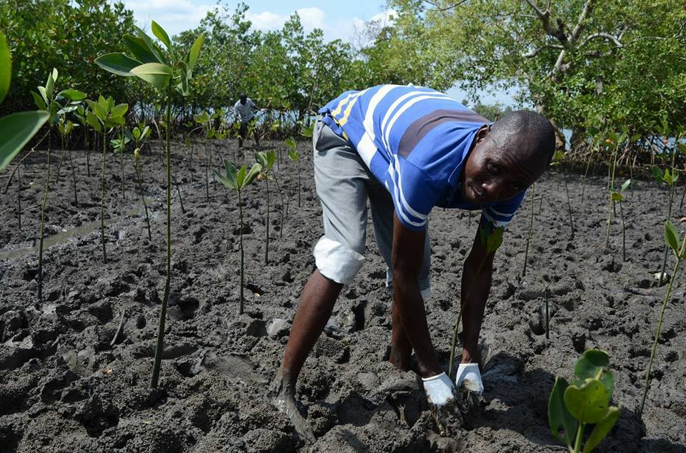
PARTNERS FOR RESILIENCE
Partners for Resilience works on building community resilience.

Slide 4
PARTNERS FOR RESILIENCE
PfR is advocating for the scale up of the Integrated Risk Management (IRM) approach to address disaster risks by specifically taking in account effects of climate change and ecosystem management. For PfR, IRM, applied in projects in 2011-2015 means :-
Anticipating (through local risk assessments) and reducing shocks and stresses to natural hazards and in development planning
Linking humanitarian and development domains, making investments disaster-proof and reducing the need for humanitarian intervention
Making investments more ‘climate smart’ and socially responsible
Improving the management of ecosystems, notably water resources, for more resilient landscapes and people
Linking local realities with global processes
Integrating disciplines and approaches to encompass different risks
Forming partnerships among communities, civil society organisations, governments and other key stakeholders
Putting people at centre-stage, building on local knowledge and resources

Slide 5
Partners for Resilience in the
Environment and Humanitarian Action Network
PfR is contributing to the ‘Policy’ theme in the EHA Work Plan by :-
Bringing expertise on providing practical ways of bridging the humanitarian/development fields in natural disaster contexts and through a climate, climate change and ecosystem management lens;
Contributing to the post-WHS Summit agenda, and particularly the 1BC. PfR is one of the Alliances whose case studies are show-cased in the 1BC.
Through EHA, PfR has acquired a research opportunity to strengthen knowledge and advocacy on risk-proof investments through collaboration with London School of Economics.

Slide 6
Driving the DRR Policy Agenda
PfR has been active in influencing the following international agreements, ensuring that IRM principles are mainstreamed in policy discussions/conference outcomes :-
PfR is a strategic partner to the Netherlands Government and often considered in formal Dutch Government delegations;
The Paris Agreement, by working closely with the Dutch Government and also using its strong Civil Society voice;
The Sendai- an instrumental framework for DRR work- and recently held Regional Platforms for DRR
The Urban Agenda, through close collaboration with the Dutch government, ensuring that issues on Urban Deltas and ecosystem
COP21 & COP22
Some Alliance members are also affiliated to other global networks and thus expands the network of actors PfR engages with. Some networks include BRACED (Building Resilience and Adaptation to Climate Extremes and Disasters); PEDRR (Ecosystems for Adaptation and Disaster Risk Reduction); The Delta Coalition

