Slide 1
Logistics Note

Slide 2
Important Facts About Ecuador – Guayaquil Ecuador, a mega diverse country, is located in the northwest of South America and crossed by the equator, from which it draws its name.
Capital of Ecuador: Quito
Area: 256,370 Km2
Population: 12,600,000 inhabitants
Official language: Spanish, Quichua is spoken in some indigenous communities. English is widely spoken, especially in large cities and tourism sites. In terms of toursim services, guides are available in Spanish English, German, French and Italian.
Currency:US Dollar
Time Zone: -5GMT in Continental Ecuador & -6 GMT in the Galapagos Islands.
Country Code: For telephone calls from outside of the country, dial + 593 + City code.
Taxes: 12 % VAT and 10 % Services in most hotels, restaurants and tourism services.
ATMs: Cirrus, Maestro, Plus, Barred. Cash advances on international credit cards.

Slide 3
Travellers checks: American Express and Visa, may be exchanged for cash at banks and exchange offices and are accepted in some hotels and by our Tour Operator.
Credit cards accepted: MasterCard, Visa, American Express, Diners.
Airport departure taxes: U.S. $ 37.93 in Quito and U.S. $ 25.00 in Guayaquil.
Guayaquil Weather: Wet, comfortable and light clothing is recommended for the heat. Nights may be windy, a light jacket is recommended.
Taxi service cooperatives : The following cooperatives are recommended:
Taxis Paradise: 04-2204232 (Request yellow taxis with security camera).
Taxis Mall del Sol April 9: 04 2082311 (Request taxi with security camera).

Slide 4
Below, we invite you to choose the most suitable hotels to ensure an excellent stay in the city of Guayaquil, Ecuador. All rates are subject to 12% VAT and 10% service, tourism rates.
Suggested Hotels
Guayaquil, Ecuador

Slide 5
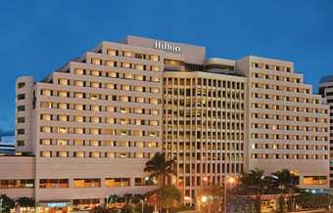
Reservations: Paulina Sacoto Tel.: (593-4) 2689000 psacoto@hiltonguayaquil.com
Hotel Hilton Colon
Deluxe single room US $ 145*
Deluxe double room US $ 155*
*These rates are not subject to 12% VAT and 10% service charge.
Address: Av. Francisco de OrellanaMz. 111
The hotel is located 10 minutes from the Jose Joaquin de Olmedo International Airport.
Main Venue of the event

Slide 6
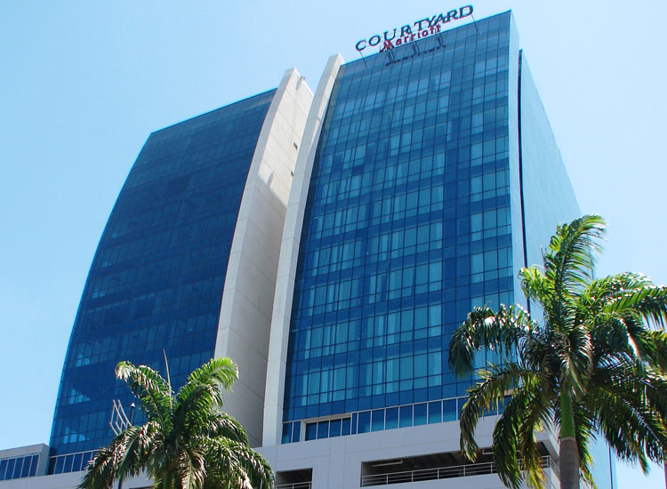
Reservations: Annie Ubilla Tel.: (593-4) 6009200 annie.ubilla@courtyard.com
Hotel Marriott
King single room: US $ 109
King double room: US $ 119
*These rates are not subject to 12% VAT and 10% service charge.
Address: Av. Francisco de Orellana 236
The hotel is located 8 minutes from the Jose Joaquin de Olmedo International Airport.

Slide 7
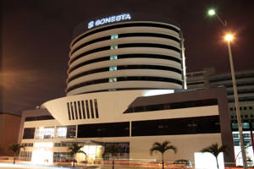
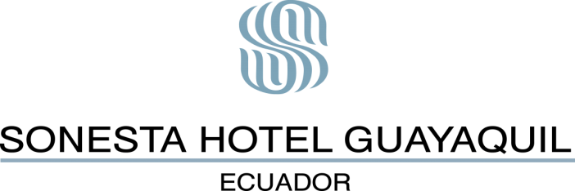
Reservations: Vanessa Cedeño Tel.: (593-4) 2595900 vanessa.cedeno@sonestaguayaquil.com
Sonesta Hotel
Single room: US $ 140
Double room: US $ 150
*These rates are not subject to 12% VAT and 10% service charge.
Address: LeopoldoBenítez, Joaquín J. Orrantía González
The hotel is located 3 minutes from the Jose Joaquin de Olmedo International Airport.
Note: The rooms do not have bathrooms for disabled guests.

Slide 8
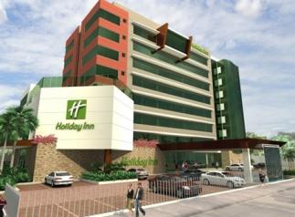
Reservations: María Rosa Wright G. Tel.: (593-4) 2 3714610 mrwright@holidayinngye.com
Holiday Inn
Single room: US $ 135
Double room: US $ 145
*These rates are not subject to 12% VAT and 10% service charge. .
Address: Av. De lasAméricas near the Jose Joaquin de Olmedo International Airport.
Nota: There are 5 rooms for disabled guests.

Slide 9
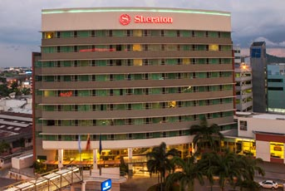
Reservations: Denise Guzmán Tel.: (593-4) 208-2088 denise.guzman@sheratonguayaquil.com
Sheraton
Superior single room: US $130*
Superior double room: US $150*
*These rates are subject to 12% VAT and 10% service charge.
Address: Plaza del Sol and Av. Joaquín J Orrantía González.
The hotel is 4 minutes from the Jose Joaquin de Olmedo International Airport.
Nota: There is one room for disabled guests.

Slide 10
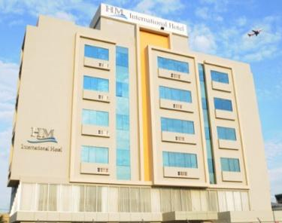
Reservations: Tatiana Cantos Telf.: (593-4) 2280806 reservas@hmhotelec.com
Hm International Hotel
Single room: US $ 74,89*
Double room: US $ 86,40*
*The includes 22% service.
Address: Kennedy Norte, Alberto Borges and 1st Passage.
The hotel is located 5 minutes from the Jose Joaquin de Olmedo International Airport.

Slide 11
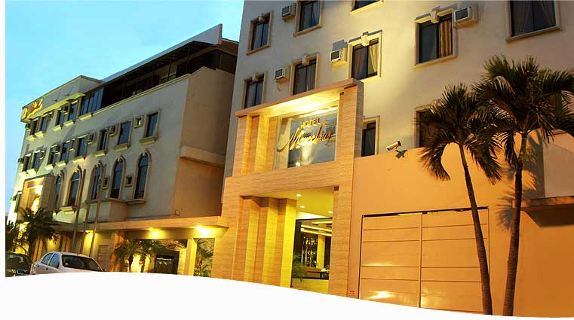
Reservations: Katherine Gonzalez Tel.: (593-4) 6026422 reservas@hotelmarcelius.com
Hotel Marcelius
Single room: US $ 65*
Double room: US $ 88*
*The rate includes 22% service.
Address: Cdla. Kennedy Norte José Falconí and José Alavedra Tama Mz. 102 Villa # 12
The hotel is located 3 minutes from the Jose Joaquin de Olmedo International Airport.
Note: The rooms do not have bathrooms for disabled guests.

Slide 12
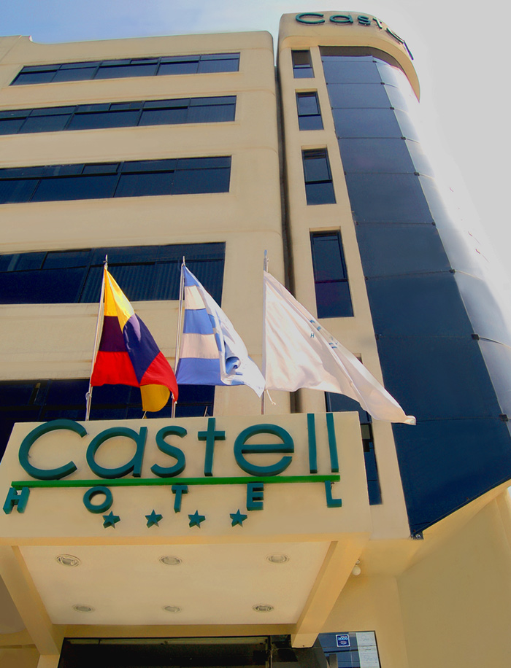
Reservations: Telf.: (593-4) 2680190 / 6002365 recepcion@hotelcastell.com
Hotel Castell
Single room: US $79.70*
Doubleroom: US $105.9*
*Therateincludes 22% service.
Address: CornerPumpilio Ulloa, Dr Miguel H. Alcivar
The hotel islocated 3 minutes fromtheJoseJoaquin de Olmedo International Airport.
Note: The rooms do not have bathrooms for disabled guests.
.

Slide 13
Restaurants
Nearthe Hotel Hilton Colón

Slide 14
Sal &Pimienta
Hotel Hilton Colón, Av. Francisco de Orellana
(04) 268-9000 ‎ · restaurantescolon.com
Price range per plate: $5 - $18
Plaza del Sol
Joaquín J Orrantía González
(04) 210-7030 mami-t.com‎
Price range per plate: $6 - $25
Noé Sushi Bar
Mall del Sol, Joaquín J Orrantía González
(04) 208-2860 noesushibar.com‎
Price range per plate: $12 - $20
Cocolón
Av. Francisco de Orellana
(04) 263-4181 ‎ · cocolon.com.ec
Price range per plate: $12 - $33
La Tasca del Norte
Ed. Torres del Norte, Av. Miguel H. Alcivar and, Nahím Isaías Barquet
(04) 268-8439 ‎
Price range per plate: $10 - $40
M
K
L

Slide 15
La parrillada del Ñato
Av. Francisco de Orellana
(04) 268-2338 ‎
Price range per plate: $10 - 30
Tony Romas
Mall del Sol, Joaquín J Orrantía González
(04) 208-2789 ‎
Price range per plate: $12 - $33
McDonald´s
Avenida Francisco de Orellana
(04) 239-4834 mcdonalds.com.ec‎
Price range per plate: $3 - $8
Patio de Comidas –San Marino Mall
Avenida Francisco de Orellana
Patio de Comidas – Mall del Sol
Joaquín J Orrantía González
M
K
L

