Slide 1
Sesión Temática 4: Inversión Pública y herramientas financieras para RRD
Sistemas de seguros, reaseguros y transferencia de riesgos
Swiss Re
Nikhil da Victoria Lobo
28 de Noviembre 2012

Slide 2
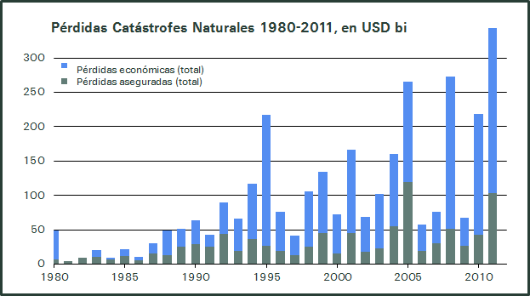
The Gap between insured and economic losses

Slide 3
Example of Chile in 2010
Chile Earthquake 2/2010 Economic Loss USD 29.7bn
Split of USD 9.3 bn reconstruction
fiscal funding requirements

Slide 4
Closing the Gap
Solution type
Description
eco- nomic
loss
foregone tax revenues
Macro
risk transfer solutions
provided directly to (sub)sovereigns
to cover their direct or indirect costs
damaged public physical assets
clean up costs
The Gap
emergency relief
livelihood assistance,
rehabilitation of the poor
Micro
insure the uninsured through simple products via aggregators such as MFIs, NGOs, and corporates
insured
loss
damaged uninsured private assets
Pooling
establishment of insurance pools
to increase insurance penetration

Slide 5
PPPs in Risk Management
Public sector
Political and legal power to set framework conditions that facilitate adaptive responses by individuals, the public and the private sectors
Typically operates under significant financial constraints. As costs of disasters rise, the ability of governments to cope with natural disasters will be stretched even further
Private sector
Financial resources but lacks the power to set up the required frameworks
Broad geographical diversification which is required to absorb these risks in a cost-efficient way
Valuable knowledge and experience in dealing with catastrophe risk management

Slide 6
Macroinsurance: CCRIF in Caribbean
Solution features
The CCRIF offers parametric hurricane and earthquake insurance policies to 16 CARICOM governments
The policies provide immediate liquidity to participating governments when affected by events with a probability of 1 in 15 years or over
Member governments choose how much coverage they need up to an aggregate limit of USD 100 million
The mechanism will be triggered by the intensity of the event (modelled loss triggers)
The facility responded to events and made payments:
Dominica & St. Lucia after earthquake (2007)
Turks & Caicos after Hurricane Ike (2008)
Haiti , Barbados, St. Lucia, Anguilla and St. Vincent (2010)

Slide 7
Pooling: TCIP in Turkey
Solution features
Payments used to offset the economic costs of earthquakes
Insured peril: Earthquake
Insured assets: Private residential dwellings
Funding: Compulsory premiums paid by homeowners; policies distributed by Turkish non-life insurers
Effect: Significantly increased penetration of earthquake coverage in Turkey
Policy coverage:
Limit of TLY 140,000
2% deductible
Additional cover can be bought from private insurers

Slide 8
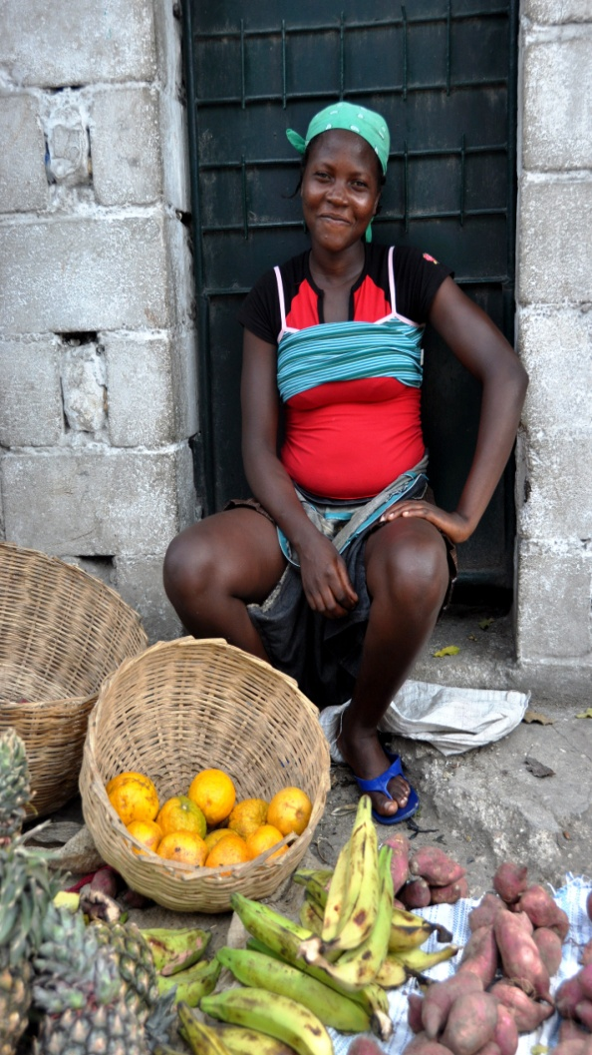
Microinsurance: MiCRO in Haiti
Solution features
Haiti is a nation that is susceptible to catastrophes and is unprepared for the costs of response
Prior to the setup of MiCRO, Fonkoze's clients bore 100% of natural disaster risk
Insured perils: Hurricane, earthquake and rainfall
Payments are made to microfinance borrowers post-disaster to reduce their loans and provide emergency cash
Parametric and basis risk policies are distributed through a local Haitian microfinance institution, Fonkoze
Trigger: Index measured at Fonkoze branches in Haiti
Basis risk absorbed by new donor funded company, MiCRO
Inception: March 2011

Slide 9
Macroinsurance: RIFCA in Dom Rep.
Solution features
Each country transfers risk to its own risk retention vehicle (captives)
Captives buy risk transfer protection (Earthquake and potentially Hurricane) from (re-)insurers / capital markets in the form of reinsurance and, potentially a cat bond
Inter-American Development Bank serves as facilitator by financing premium and advising on setup of Facility
Captive
Captive
Country A
Country A
Country B
Country B
Country C
Country C
Country Z
Manager
Country Z
Manager
Auditor
Auditor
Country A
Country A
Country B
Country B
Country C
Country C
Country Z
Country Z
IDB
Captive
IDB
Captive
Captive
Captive
Captive
Captive
Captive
Captive
Cat Bond
Cat Bond
Reinsurance
Reinsurance

Slide 10
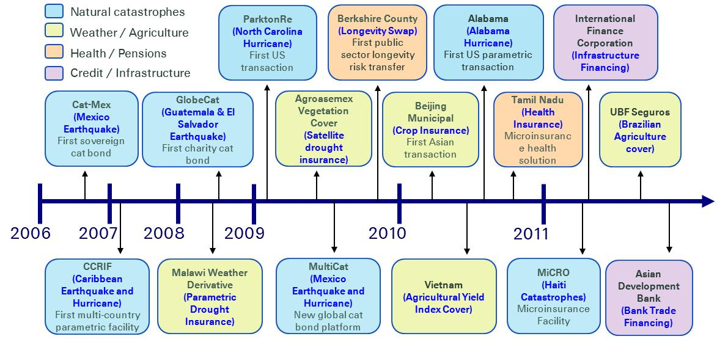
A growing approach to risk management

Slide 11
Closing the gap between economic and insurance losses is key to long term development
Nikhil da Victoria Lobo
nikhil_davictorialobo@swissre.com
www.swissre.com/about_us/global_partnerships

