Slide 1
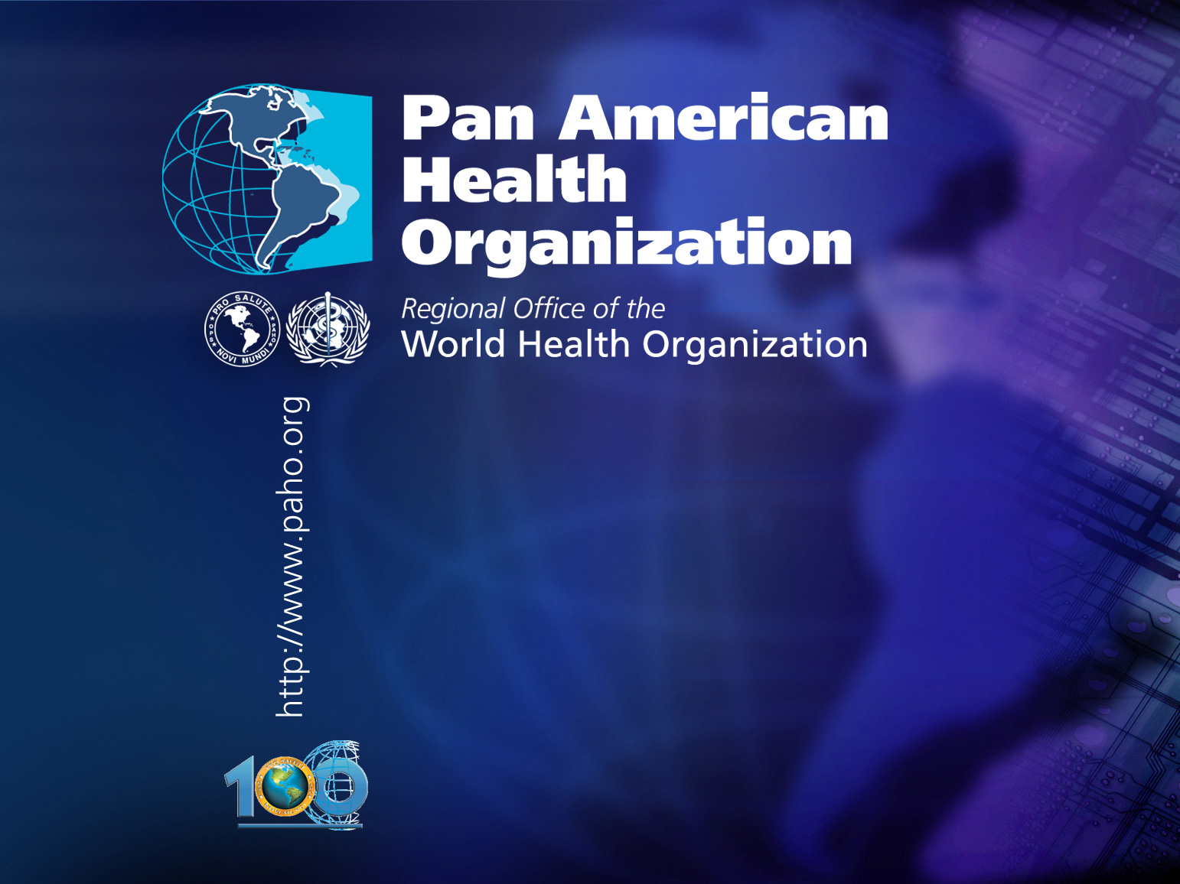
.
.
Advances in the implementation of the Regional Plan of
Action on Safe Hospitals
Dr. Ciro Ugarte
Regional Advisor
Disaster Risk Reduction
and Emergency Preparedness

Slide 2
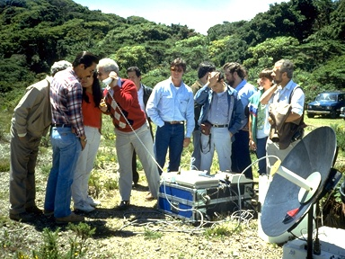
Based on lessons learned from disasters…
In 1976 after a series of disasters (70, 72, 76), the Ministers of Health in the Americas decided to establish an Emergency Preparedness and Disaster Relief Program.

Slide 3
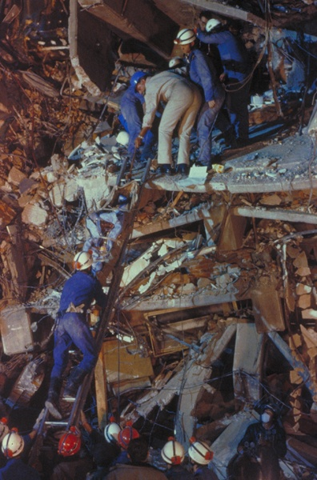
The trigger
From 1976 to 1985, hospital preparedness and mass casualty management was the main concern for the countries.

Slide 4
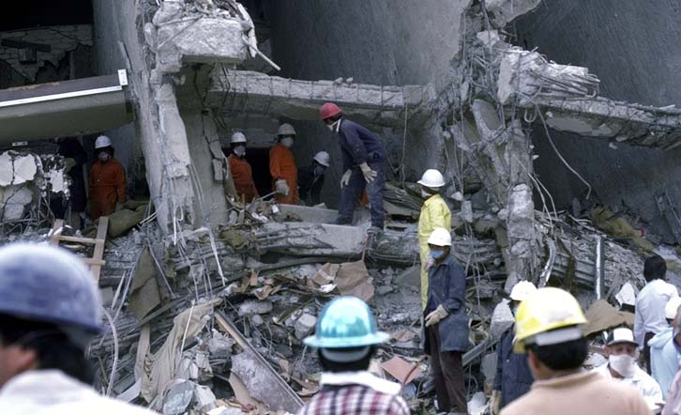
Earthquake in Mexico, 1985

Slide 5
The problem
More than 67% of the nearly 18,000 hospitals in Latin America and the Caribbean are located in areas at higher risk of disasters.
Hospitals are a huge investment and represent close to 70% of the Ministries of Health budget.
In the Americas, 61% of the impact on health facilities is caused by earthquakes; 17% by hurricanes; 14% by floods and 8% by health emergencies.
Consequence: 45 million people without proper health care and more than 5 billion dollars in direct costs.

Slide 6
From preparedness to mitigation
After the 1985 Mexico earthquake, many initiatives were implemented to reduce the vulnerability of health facilities:
  International Course on Planning, Desing and Construction of Hospitals in Seismic Zones
  Technical publications on mitigation in health facilities: structural, non-structural and functional.
  International Conference on Vulnerability Reduction in Health Facilities
  Hospitals Vulnerability Studies in more than a dozen countries.
  PAHO/WHO Collaborating Center
  Disaster Mitigation Advisory Group (DiMAG)

Slide 7
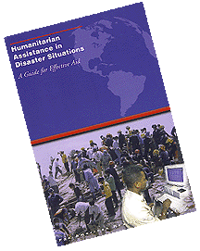

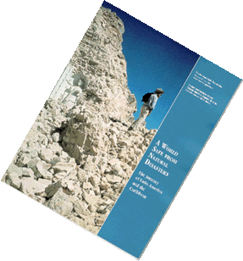
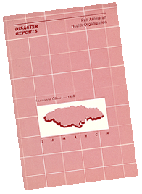


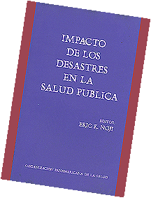
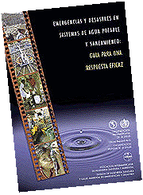

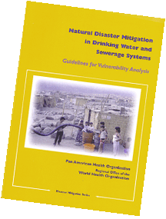

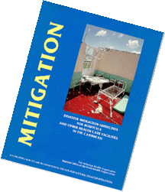


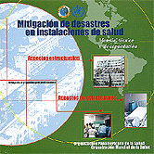
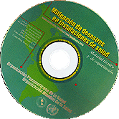
Scientific Publications www.paho.org/disasters

Slide 8
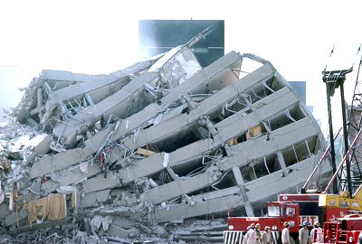
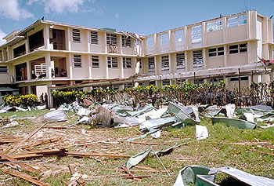
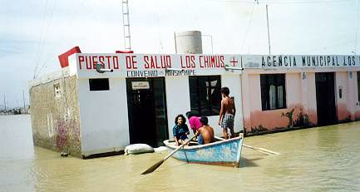
Hundreds of hospitals and thousands of other health facilities are affected by natural phenomena
EARTHQUAKES
Peru, 1970
Nicaragua, 1972
Guatemala, 1976
Mexico, 1985
Colombia, 1999
El Salvador, 2001
Peru, 2007
Haiti, Chile, Mexico, 2010
HURRICANES
Jamaica, H. Gilbert, Dominican Republic, H. George
Honduras and Nicaragua, H. Mitch, 1998
Grenada, H. Ivan, 2004
United States, H. Katrina, 2005
Guatemala, H. Stan, 2006
Nicaragua, H. Felix, 2007
Cuba, H. Gustav & Ike, 2008
Jamaica, Cuba, USA, H. Sandy, 2012
OTHER PHENOMENA
Colombia, volcanic avalanche, 1985
Peru & Ecuador, El Niño Phenomenon, 1997
Argentina, floods, 2003
Haiti & Dominican Republic, landslides, 2004
Mexico, floods, 2007
Mexico, Chile, Argentina, Pandemic H1N1 2009
Brazil, Colombia, Mexico, Central America, floods 2010, 2011, 2012

Slide 9
Vulnerability reduction initiatives at country level (1985-2003)
Colombia: development
Costa Rica: fire
Chile: new investment
Peru: civil defense
El Salvador: reconstruction
Bolivia: guidelines
Cuba: international seminars
Nicaragua: national committee
Mexico: certification
Andean Community: Disaster reduction priority

Slide 10

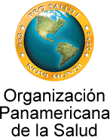


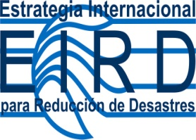

Regional Meeting
Hospitals in Disasters: Handle with Care
El Salvador, 8-10 July 2003

Slide 11
DRR at the Country Level
In theory, the countries should ensure that each sector and institution is resilient to disasters and assign all the necessary resources to obtain adequate results in all aspects of risk reduction.
In practice, the best strategy results upon prioritizing the interventions in those components that are essential for the community in case of disasters and therefore should remain operational when they are most needed.

Slide 12
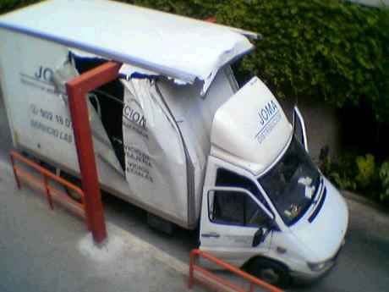
Think Big…?

Slide 13
Disaster Risk reduction in the Health Sector
In theory, the health sector should be able to ensure that all health facilities are safe from disasters.
In practice, it is necessary to begin increasing the safety of those health services that are located in high risk areas and that provide essential life-saving health care services.

Slide 14
From
Vulnerability Reduction in Health Facilities
to
Safe Hospital

Slide 15
Agreement in the Americas
To urge Member States to adopt “Hospitals Safe from Disasters” as a national risk reduction policy, set the goal that all new hospitals are built with a level of protection that better guarantees their remaining functional in disaster situations,
and implement appropriate mitigation measures to retrofit existing health facilities, particularly those providing primary care.
45th Directing Council, 2004
Pan American Health Organization
World Health Organization

Slide 16

“Integrate disaster reduction planning in the health sector; Promote the goal of Safe Hospitals to ensure that all new hospitals are built with a level of protection that better guarantees their remaining functional in disaster situations,
and implement appropriate mitigation measures to reinforce existing health facilities, particularly those providing primary care.”
Hyogo Framework for Action 2005–2015:
Building the Resilience of Nations
and Communities to Disasters

Slide 17
Levels of Protection of a Safe Hospital
Life Protection (patients, health personnel and visitors)
Investment Protection (equipment, supplies, furniture and utility services)
Operational Protection (facility’s capacity to provide health care).

Slide 18
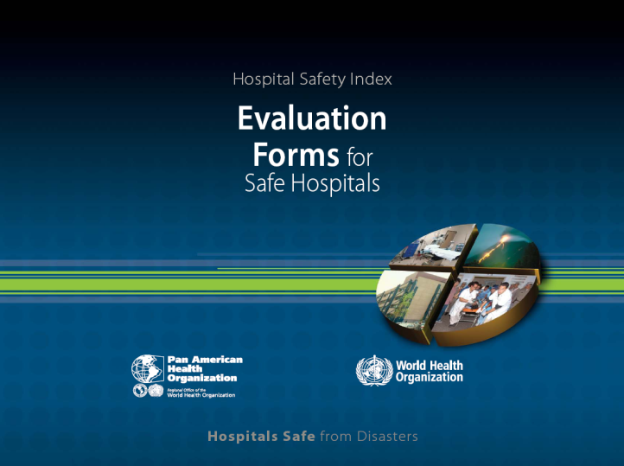
Regional Initiative on Safe Hospitals
27th Pan American Sanitary Conference
1-5 October 2007
Round Table on Safe Hospitals: A Goal within our Reach
49th PAHO/WHO Directive Council
28 September - 2 October, 2009

Slide 19
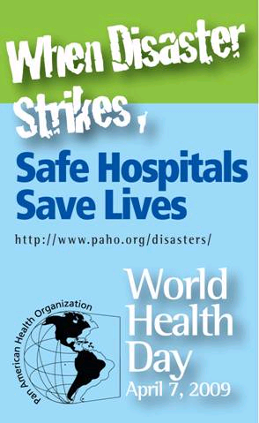
World Health Day 2009

Slide 20
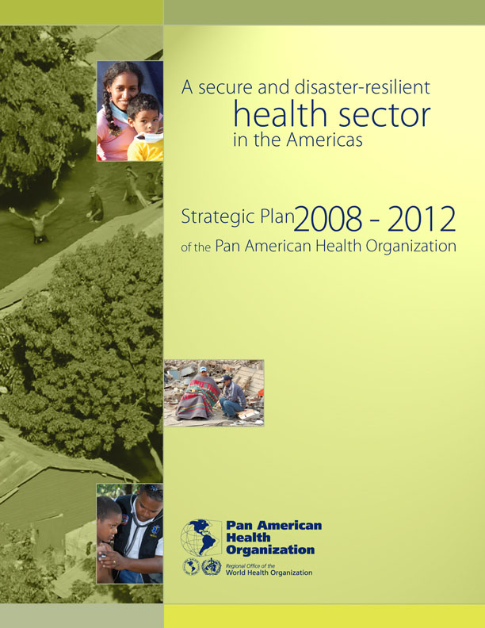
Regional Strategic Plan
2008 - 2012
A secure and disaster-resilient
health sector in the Americas
“A future when there is adequate, nationally-led and sustained capacity to reduce disaster risk in the health sector, both to prevent damage
to infrastructure and service delivery
and to provide a timely
and effective response to disasters.”

Slide 21
Safe Hospitals Strategy
National and international agreements
Adoption of appropriate norms and standards
Promotion of other sectors participation
Incorporation of protection criteria at the hospital design phase
Implementation of safety measures in existing health facilities
Strengthening emergency preparedness
Monitoring the implementation of national safe hospitals programs

Slide 22
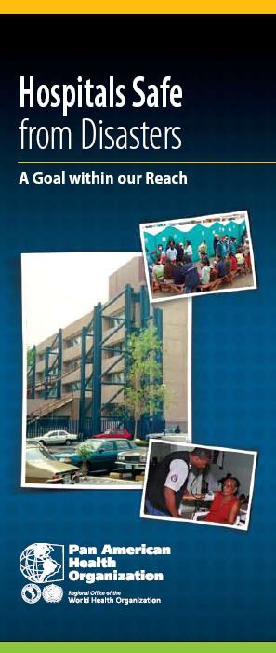
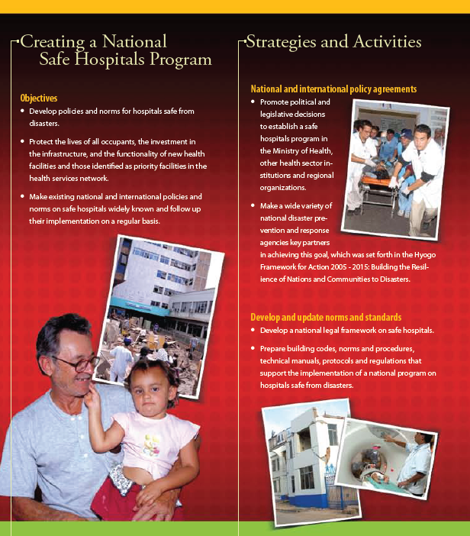
Creating a
National Safe Hospitals Program

Slide 23
Traditional Hospital Vulnerability Assessment
Hazard and Vulnerability Analysis
Structural Assessment
Non Structural Assessment
Equipment and Critical Lines Studies
Organizational/Functional Evaluation
All these studies are very good but they usually last several months and cost tens of thousands of dollars.

Slide 24
Hospital Safety Index
Safe Hospitals Checklist
Mathematic Model (Safety Index Calculator)
Hospital Safety Index

Slide 25
32 Countries and Territories in the Region apply the Hospital Safety Index
Anguilla
Argentina
Bahamas
Barbados
Belize
Bolivia
Brazil
Chile
Colombia
Costa Rica
Cuba
Dominica
Dominican Republic
Ecuador
El Salvador
Grenada
Guatemala
Guyana
Honduras
Jamaica
Mexico
Montserrat
Nicaragua
Panama
Paraguay
Peru
Saint Kitts and Nevis
Saint Vincent & the Grenadines
Suriname
Trinidad and Tobago
Uruguay
Venezuela

Slide 26
HSI results of the first 1524 hospitals assessed
Category A 46 %
Category B 37 %
Category C 17 %
Safety index | Category Type | What should be done?
0 – 0.35 | Category C | Urgent measures to protect the life of patients and hospital staff
0.36 – 0.65 | Category B | Necessary measures are required in the short term to reduce losses
0.66 – 1 | Category A | Preventive measures are required to maintain and improve safety

Slide 27
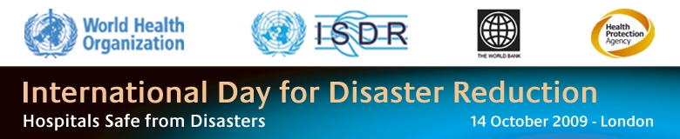
Europe

Slide 28
South East Asia

Slide 29
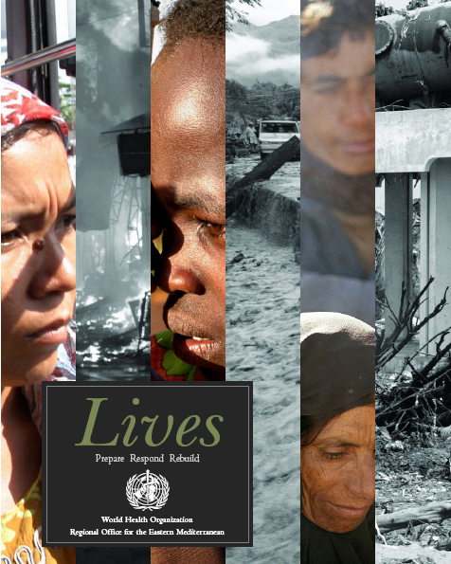
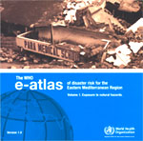
East Mediterranean
المستشفيات المأمونة من الكوارث الطبيعية
The 2005 Pakistan Earthquake destroyed 388 of the796 health facilities.
A Group of Experts was created to validate safe hospital assessment tools and to elaborate a Regional Implementation Framework.
Electronic Disaster Risk Atlas

Slide 30
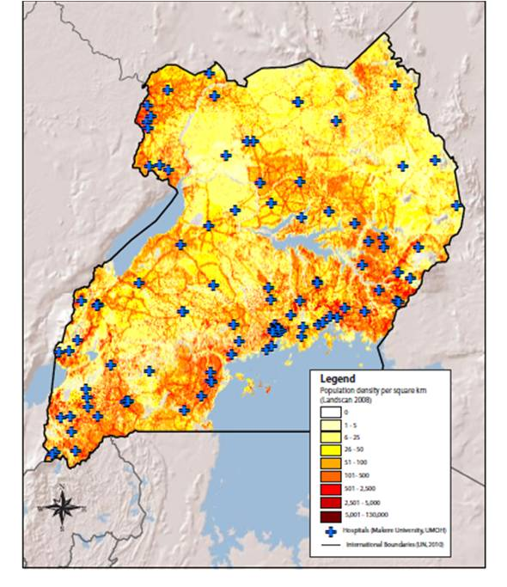
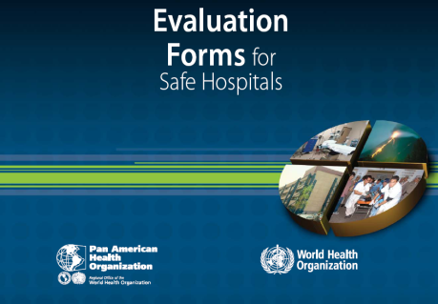
Africa:
Uganda experience
Health facilities./services
Vulnerability / Capacity
Missing health facility
Vulnerability / capacity information
Hospital Safety Index
Health Information System
Health facility registry

Slide 31
Plan of Action on Safe Hospitals
2010 – 2015
80% of MS with national safe hospitals program. (48% / 57% / 91%)
90% of the countries monitor hospitals construction or remodeling. (91%)
80% of the countries with independent supervision mechanisms. (26%)
All countries ensure that all new health facilities are operational in disasters. (60%)
90% of the countries have updated standards for the design, construction, and operation of new, safe health facilities. (60%)
90% of the countries improve the safety of the existing health facilities. (35%)

Slide 32
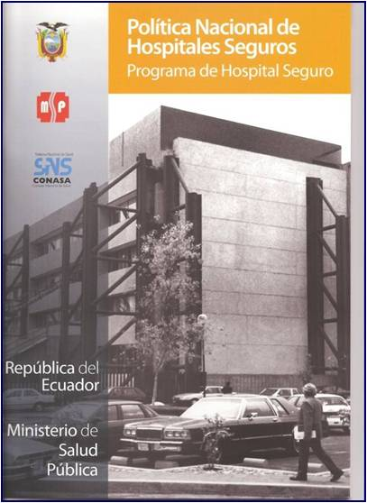
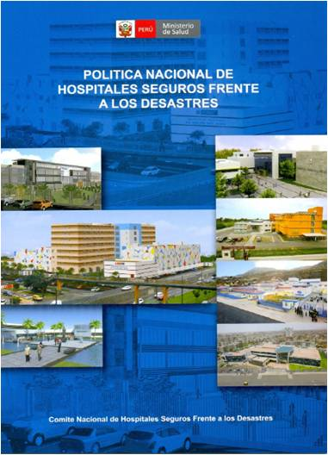
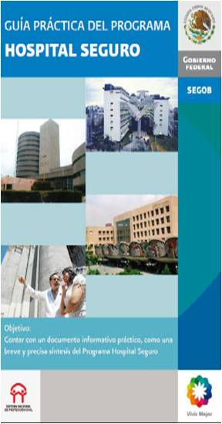
Current situation in the Americas
28 countries have included DRR as a component of their HDP
21 countries have design norms for health facilities
32 countries and territories in the Region apply the Hospital Safety Index.
20 Countries have a National Policy on Safe Hospitals and 17 have a Safe Hospitals Program.
57% of the hospitals in category “B” and “C” are implementing corrective measures

Slide 33
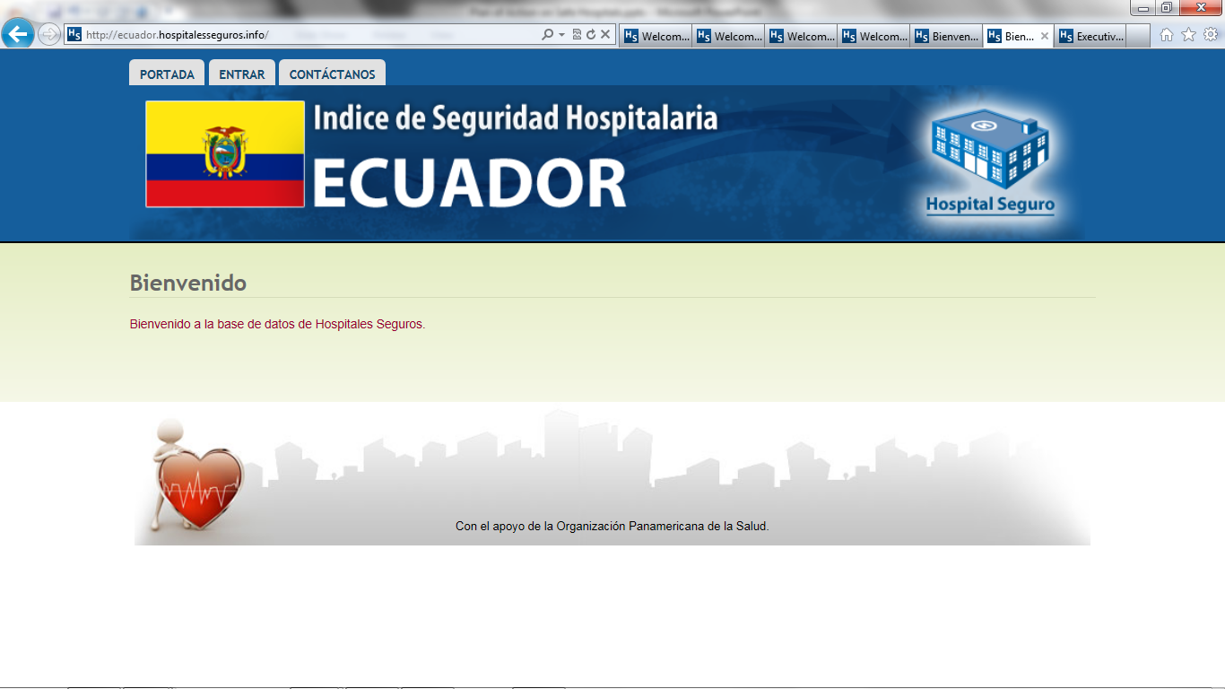
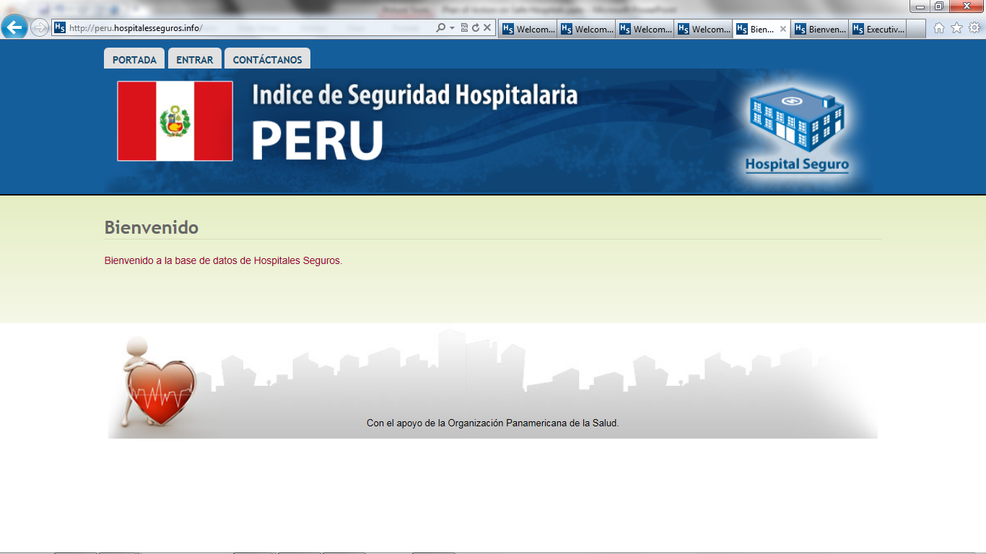
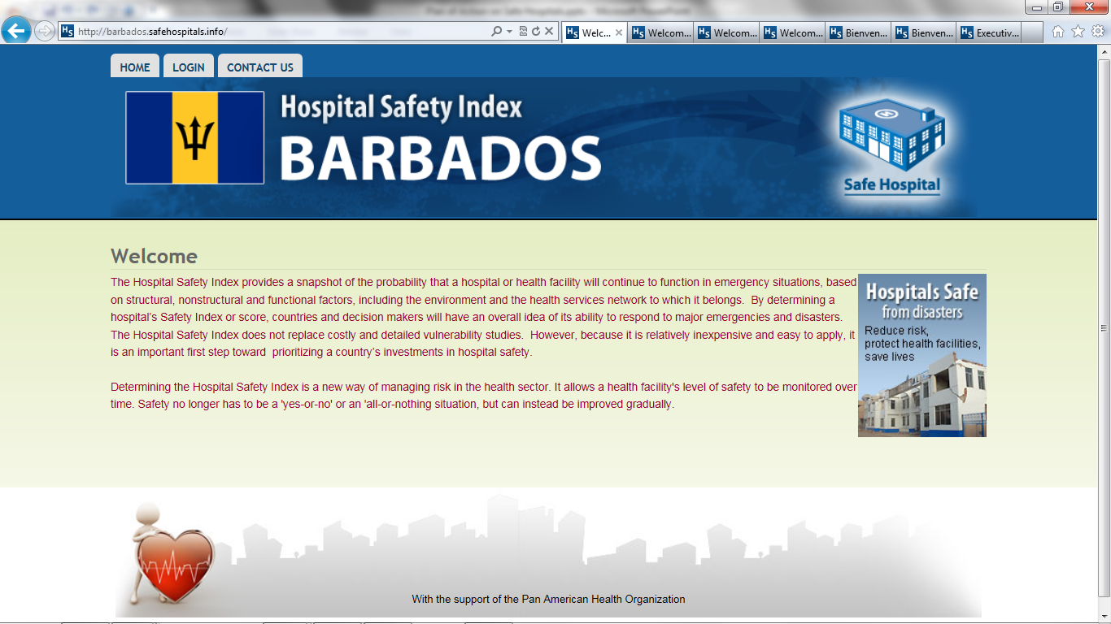
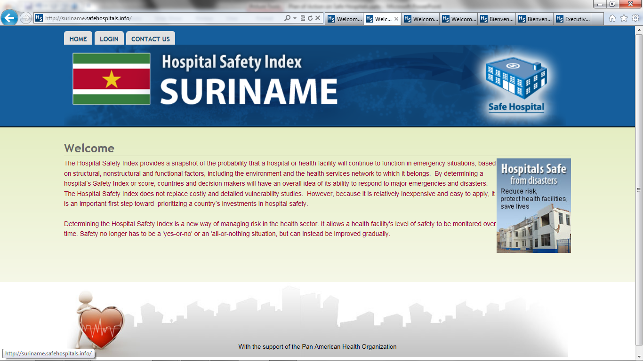
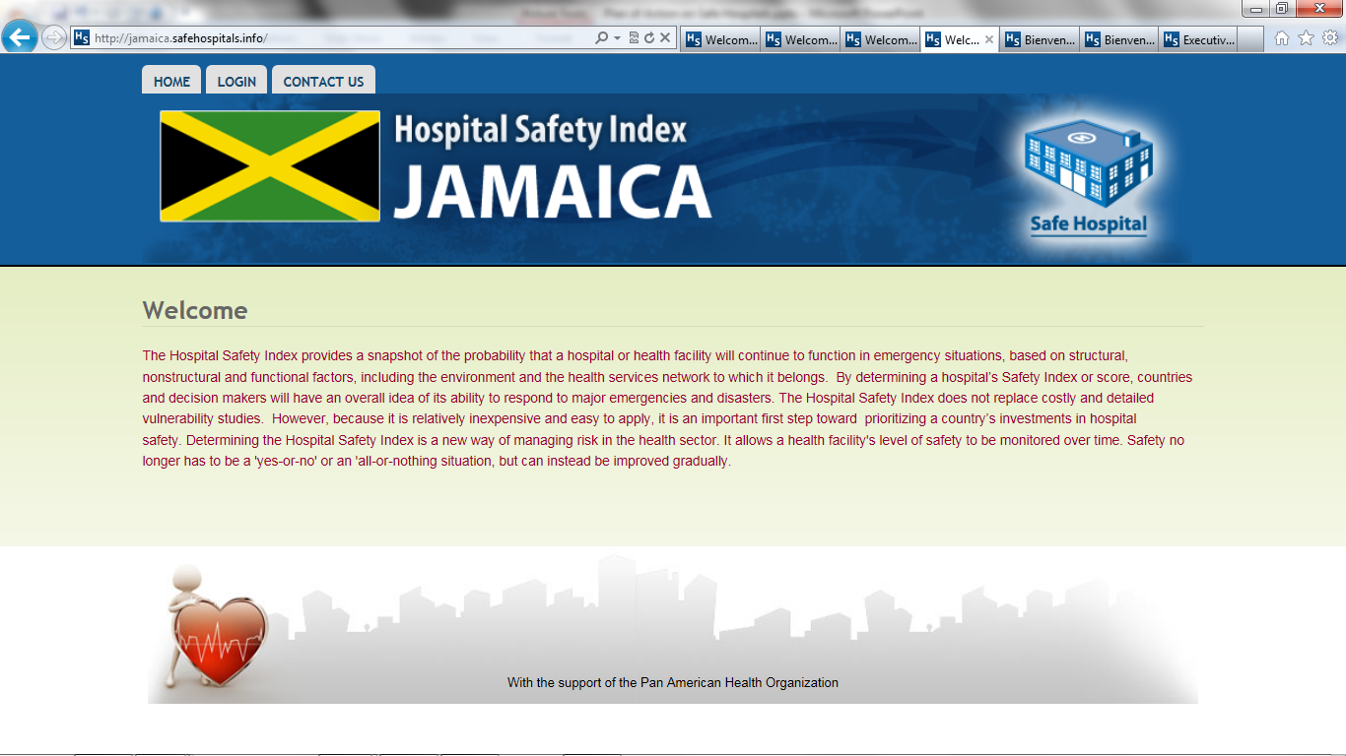
Safe Hospitals Mapping Database

Slide 34
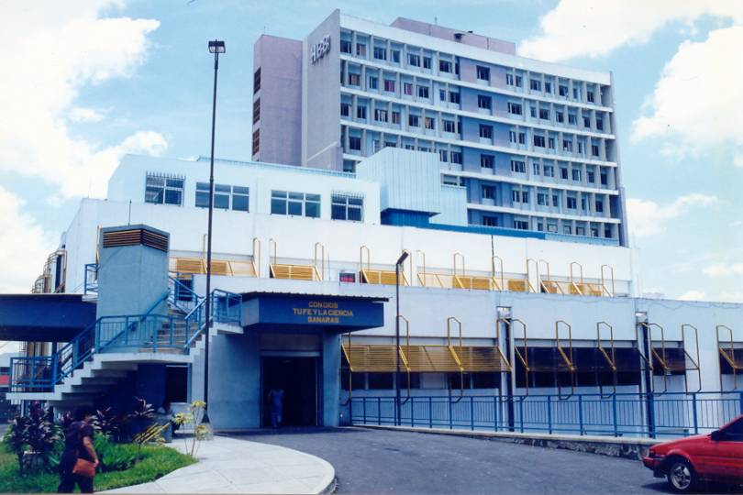
The Future
Regional Plan of Action on Safe Hospitals with non-health actors too
New standards for the design of safe hospitals
Check consultant mechanism
Smart hospitals: green and safe

Slide 35
.
.
Regional Plan of
Action on Safe Hospitals
and National Experiences
Dr. Ciro Ugarte
Regional Advisor
Disaster Risk Reduction
and Emergency Preparedness

