Slide 1
Country Statement to the Regional Platform for Disaster Risk Reduction in the Americas II Session – The Virgin Islands
Presented by Simone Lettsome-Nibbs
Department of Disaster Management

Slide 2
Overview
Major Achievements in Disaster Risk Reduction
Major Obstacles
Outlook for 2011-2013

Slide 3
Snapshot of Hazard & Vulnerability Assessment (HVA) Process
For Subdivision of Land
  Use hazard data available for various hazards on GIS database (i.e. landslides, storm surge, seismic, flooding, etc)
  Make recommendations for mitigation measures based on hazards identified
  Determine if proposed lots are suitable for future development.

Slide 4
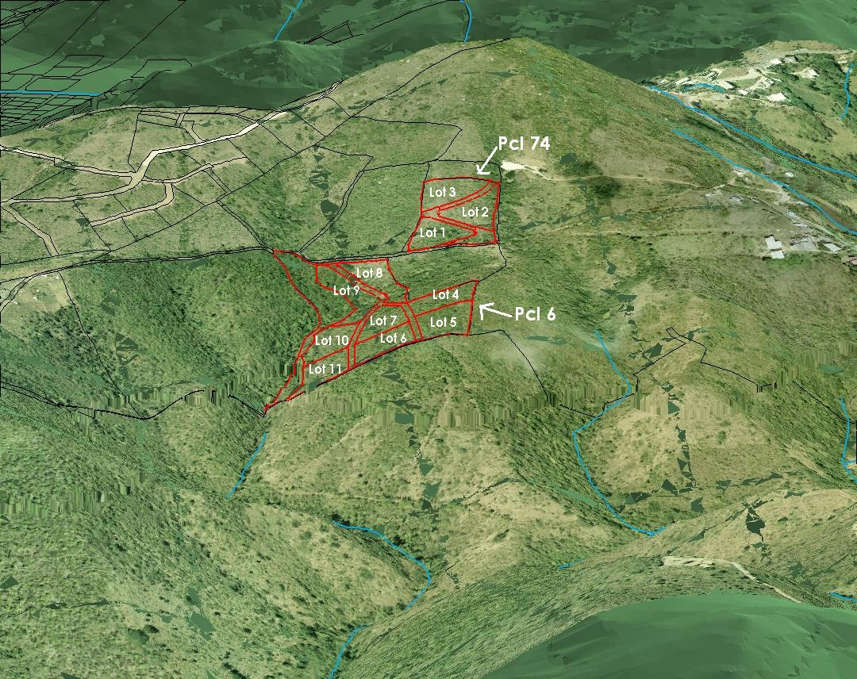
3-D Scene for a Proposed Subdivision

Slide 5
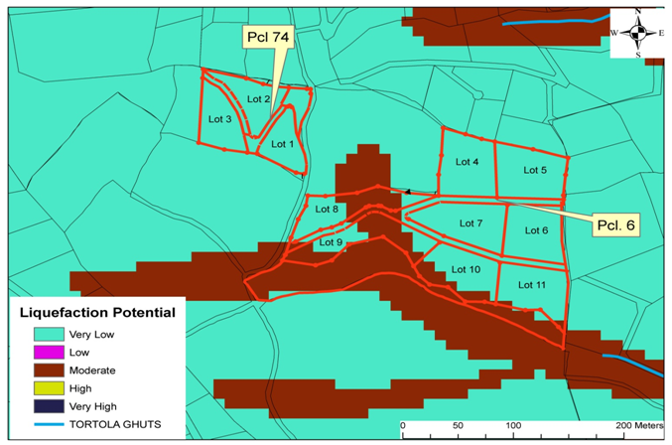
Hazard Risk Map

Slide 6
Snapshot of Hazard & Vulnerability Assessment (HVA) Process
For Proposed Land Development
  Use hazard data available for various hazards on GIS database (i.e. landslides, storm surge, seismic, flooding)
  Make recommendations for mitigation measures based on hazards identified
  Determine if the proposed development is suitable for the lot available or does it need to be adapted to suit.

Slide 7
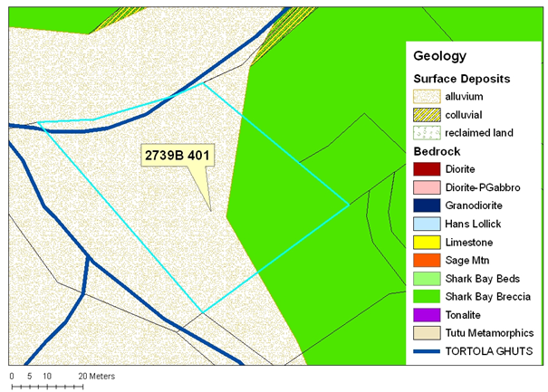
Hazard Risk Map - Ghut

Slide 8
Disaster Management/Contingency Planning
As part of the Planning Process, major developments are required to prepare disaster management/contingency plans for the operational and construction phase of their developments.
These, along with monitoring plans, are submitted to a number of agencies, including the DDM, for approval.

Slide 9
Comprehensive Disaster Management
In 2009, a Comprehensive Disaster Management (CDM) Policy and CDM Strategy and Programming Framework 2009-2013 were developed for the Virgin Islands and were approved by Cabinet for implementation.
The DDM has adopted the Results Based Management (RBM) Framework to plan, implement, monitor, evaluate and report on programmatic and project outcomes and outputs under its policy and strategic programming framework.

Slide 10
MER System
The DDM has developed an MER Framework to monitor, evaluate and report on programmatic and project outcomes and outputs within any instrument.
The VI MER is designed on an IT platform that allows for monitoring, evaluating and reporting on any instrument with defined indicators.

Slide 11
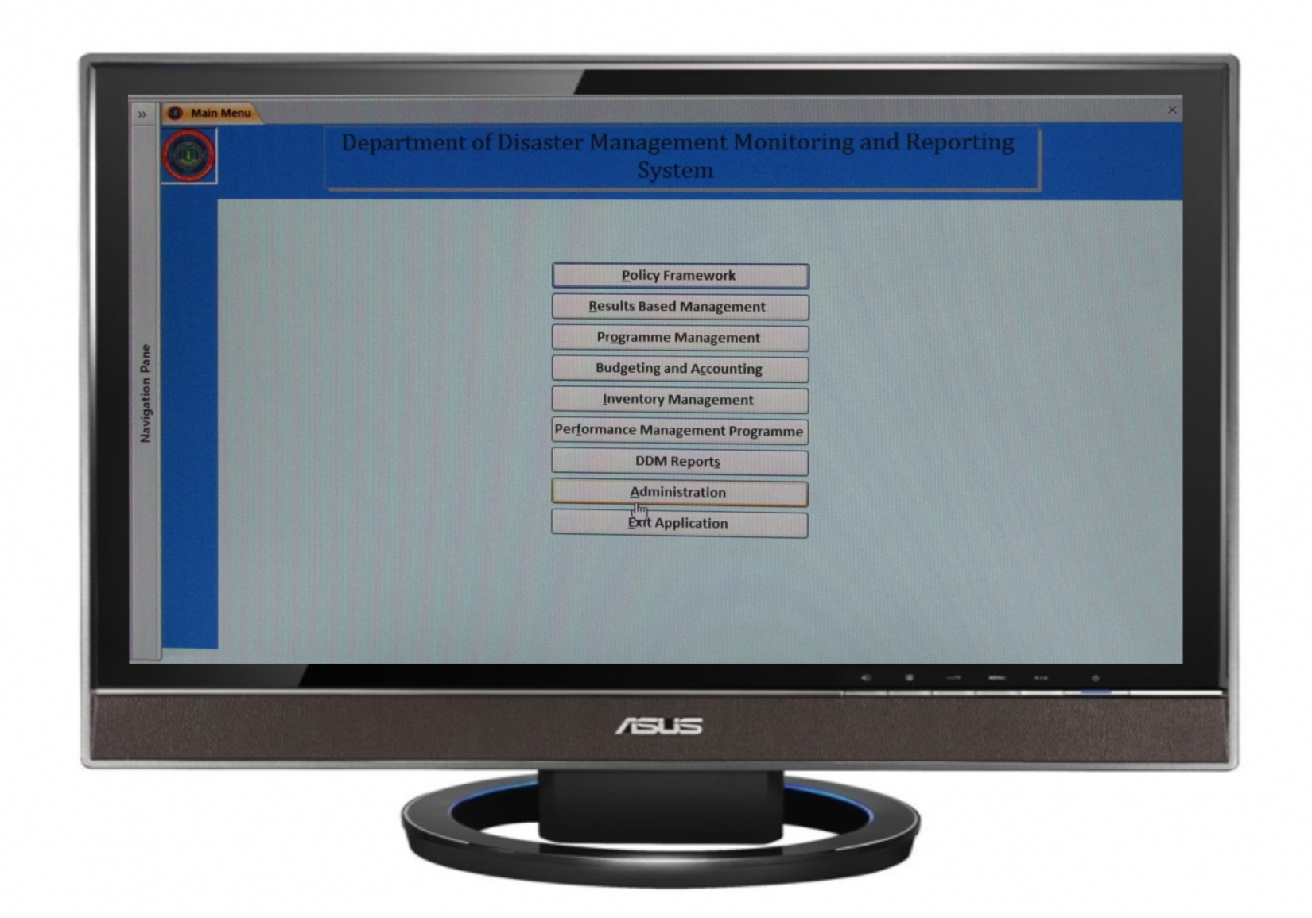
MER - Screen Shot of Front Page

Slide 12
Disaster Management Act, 2003
Currently being revised to allow for a more comprehensive approach to CDM and to address weaknesses in the current legislation.
This will allow for greater enforcement and definition of DRR responsibilities. It will also provide a more streamlined process between the CDM Policy, Strategy, Legislation and National Disaster Management Plan.

Slide 13
Major Obstacles
Absence of data to allow for comprehensive approach to DRR
We are hopeful, that under the R3i Project, we will get the high resolution Storm Surge and tsunami modeling for the Virgin Islands.
Additional data sets are required for microzonation, soil, slope/cut, flood and DEM (digital elevation model).

Slide 14
Major Obstacles (cont’d)
There is a need to continuously upgrade communications and early warning systems. These require significant investment and continuous maintenance.

Slide 15
Outlook for 2011-2013
Continue to incorporate sustainable concepts and environmental protection into the disaster management program through our capacity building program – internally and society wide.
Continue to function on the Planning Authority to ensure that risk reduction measures are incorporated into planning and development

Slide 16
Outlook for 2011-2013 (cont’d)
Continue to collaborate with public ad private sector to ensure that DRR and CDM are integrated within sectors and filtered down to the community level. (e.g. Safe School Initiative – certification for educational institutions)
Complete community profiles for all major community groupings in the VI to define community needs and allow us to design better community based programs.

Slide 17
Thank you for your attention!

